Slide 1

Kirk: Scotty, I need more power …
Scotty: I’ve giv’n her all she’s got, Captain …
Kirk: … It’s not enough Scotty !!!
Aron Gampel, Scotiabank Economics October 2016
Notes:
1

Slide 2
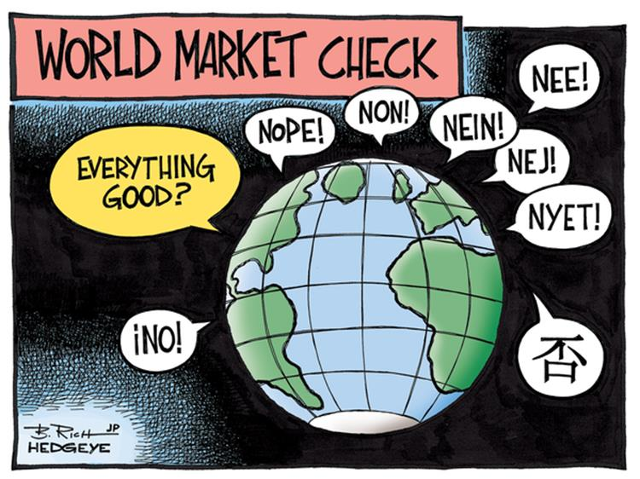

Slide 3
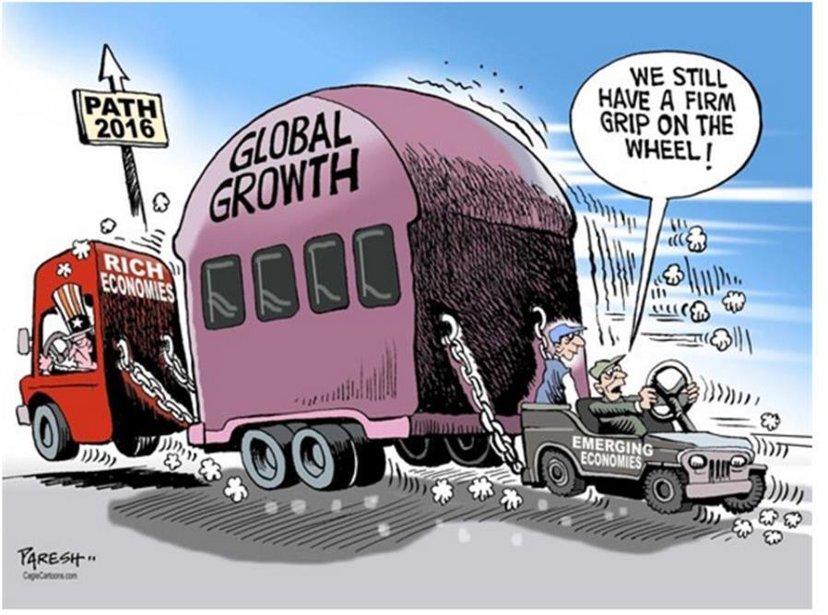
Global Growth Is Not Synchronized

Slide 4
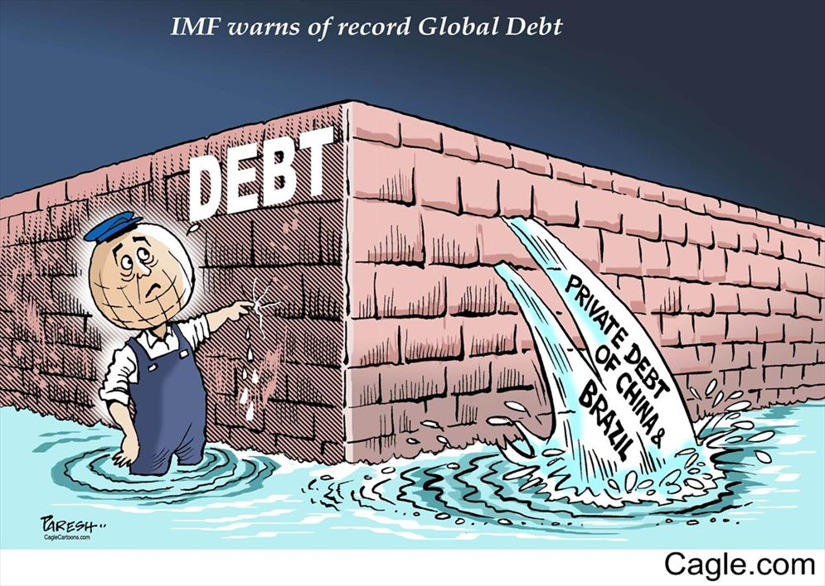
Debt Is Still A Four-Letter Word

Slide 5
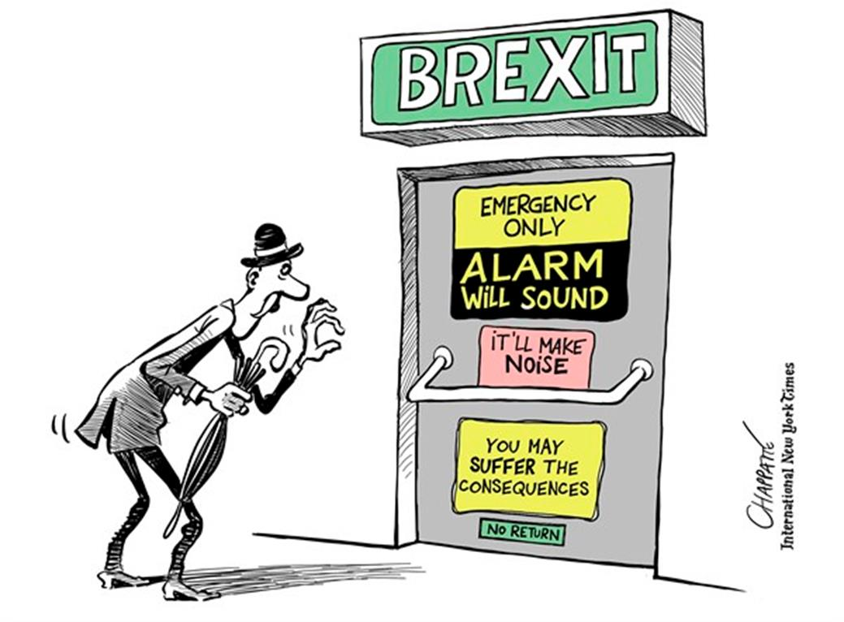
There Are Increasing Geopolitical Risks In The U.K. …

Slide 6
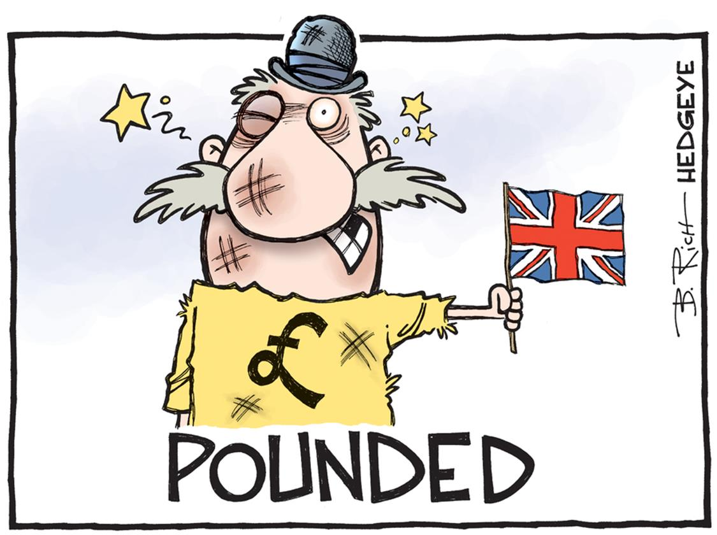

Slide 7
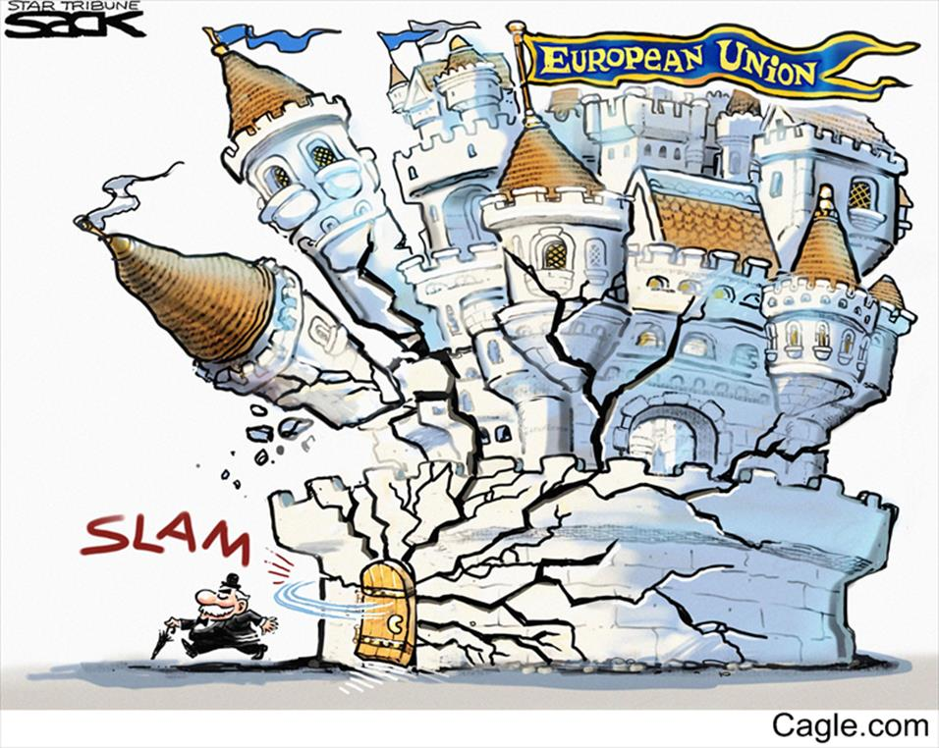
... Throughout Europe ...

Slide 8
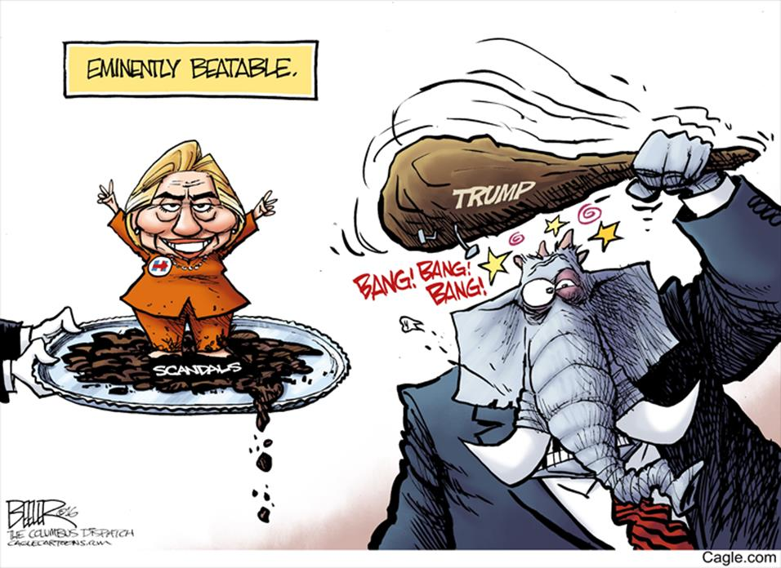
… And In The United States As Well …

Slide 9

... Although The Republicans Face An Uphill Battle

Slide 10
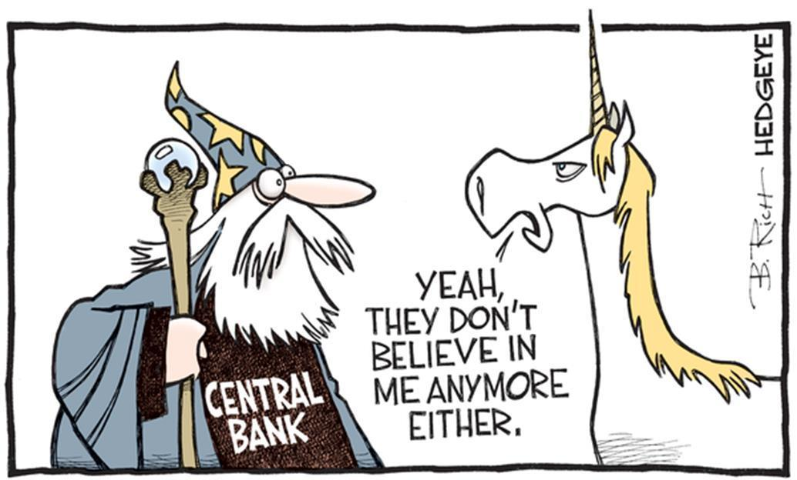
There Is Less Confidence In Monetary Policymakers …
Notes:
10

Slide 11


Slide 12

... And In Policymakers In General

Slide 13
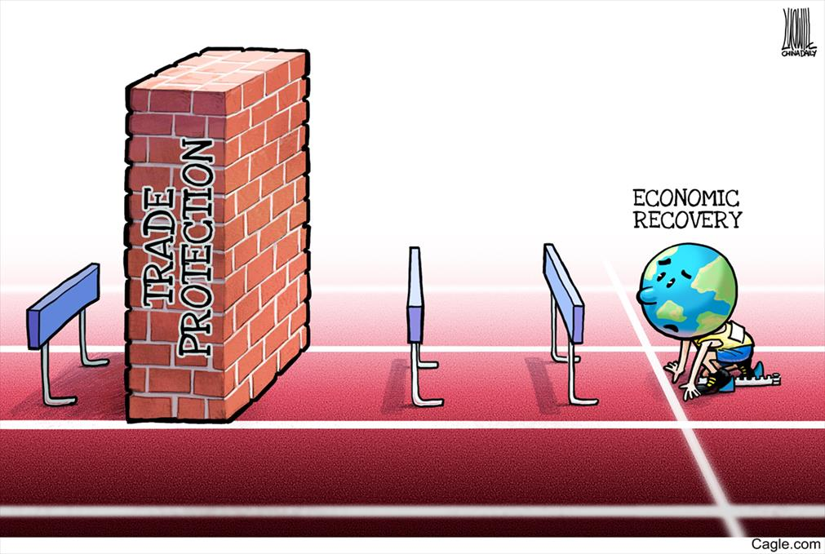
Protectionism Threatens Global Trade And Growth ...

Slide 14
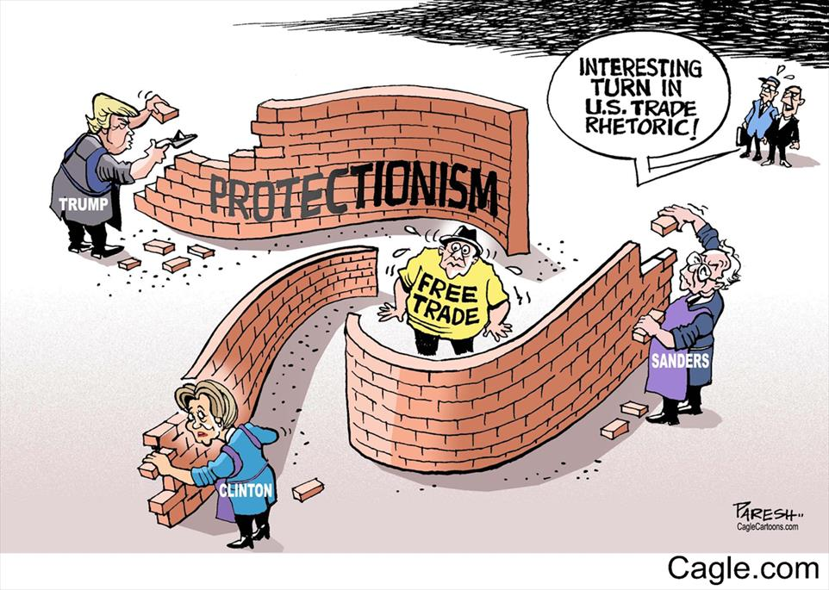
… While Walls Have Already Gone Up In The U.S.

Slide 15
Persistent Headwinds To Stronger Global Growth
‘Insufficient Aggregate Demand Reinforced By Structural And Cyclical Factors’
Structural economic adjustments
Debt and deleveraging
Oversupply conditions in product markets
Low inflation and deflation
Banking sector oversight and profitability
Slowdown in international trade
Financial and currency market volatility
Geopolitical risks/populism, civil strife, terror, weather, health

Slide 16
Slow Growth And Economic Underperformance Likely To Persist
Mature Nations
Emerging Market Nations
real GDP, annual % change
real GDP, annual % change
2000-07
2000-07
Source: Bloomberg, Scotiabank Economics.
Notes:
Updated

Slide 17
Global Growth Remains Moderate
World Real GDP
annual % change
2000-07 average
4.5%
Forecast
3.2%
2010-15 average
3.8%
Source: IMF, Scotiabank Economics.
Forecasts as of July 6, 2016.

Slide 18
Commodity Prices Are Still Under Pressure
Commodity Prices
index January 2004=100
Energy
Metals & Minerals
Agriculture
Forestry
Source: Bank of Canada, Scotiabank Economics.

Slide 19
World Trade Flows Remain Weak
World Trade Volumes
y/y % change
Source: CPB Netherlands Bureau For Economic Policy Analysis, Scotiabank Economics.
Data plotted through May 2016.

Slide 20
Orders And Industrial Activity Are Still Soft
Awaiting More Global Orders
index
6 month annualized % change
Global New Orders (LHS)
Global Industrial Production (RHS)
Source: U.S. Census Bureau, CPB Netherlands Bureau For Economic Policy Analysis, Scotiabank Economics.
Notes:
done

Slide 21
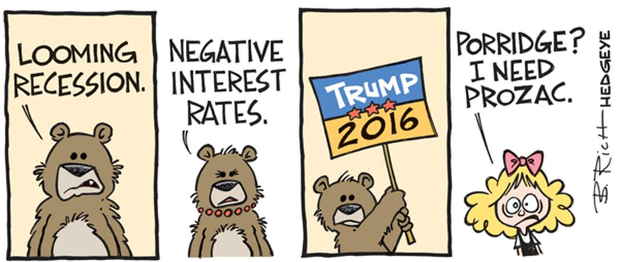
However, Is The Bearish Sentiment Over Done ???

Slide 22
The ‘Growth Pump’ Is Being Primed
Consumer-led U.S. growth
China’s growth appears to be stabilizing
Oil prices are still low
Interest rates are very low
Currencies are being realigned
Some nations are increasing fiscal stimulus
Trade deals are awaiting to be signed

Slide 23
U.S. Labour Market Conditions Have Improved Significantly
U.S. Employment
average monthly job gain, 000s
Source: U.S. BLS, Scotiabank Economics.
Data plotted through June 2016.

Slide 24
Pent-up Demand Is Lifting U.S. Spending
U.S. Auto, Home Sales and Starts
index 2004Q1=100
Motor Vehicle Sales
Home Sales
Housing Starts
Source: U.S. BEA, NAR, U.S. Census Bureau, Scotiabank Economics.
Data plotted through 2016Q2.

Slide 25
U.S. Industrial Activity Showing Some Signs Of A Turnaround
U.S. Industrial Production
y/y % change
*
Six-Month Trend
Source: U.S. Federal Reserve, Scotiabank Economics.
Data plotted through June 2016.

Slide 26
Yet Orders And Business Investment Are Still Weak
U.S. Orders – No Signs Of Lift-Off
y/y % change
*
Six-Month Trend
Capital Goods Orders Excluding Aircraft & Defense
Source: U.S. Census Bureau, CPB Netherlands Bureau For Economic Policy Analysis, Scotiabank Economics.
Notes:
done

Slide 27
Canada Benefits From A Strengthening U.S. Economy …
Real GDP
y/y % change
Canada
forecast
United States
Source: Statistics Canada, U.S. BEA, Scotiabank Economics.

Slide 28
… And The Canadian Dollar Is Tied To Rising Commodity Prices
Canadian Dollar
CADUSD
WTI Oil (US$/bbl)
Canadian Dollar
(LHS)
forecast
WTI Oil
(RHS)
Source: Bank of Canada, Statistics Canada, Scotiabank Economics.

Slide 29
Exports Have Been Slow To Regain Stronger Momentum
Canadian Non-Resource Export Volumes
y/y % change
Source: Statistics Canada, Scotiabank Economics.

Slide 30
Growth Remains Imbalanced
Canadian Real GDP
index January 2013=100, 3mma
Export-related
Commodity-related
Rest of the economy
Source: Statistics Canada, Scotiabank Economics.

Slide 31
Energy Sector Cutbacks Weighing On Capital Investment
Canadian Business Investment
annual % change, constant dollars
forecast
Source: Statistics Canada, Scotiabank Economics.

Slide 32
Consumer Spending Restrained By Softer Job/Income Fundamentals
Canadian Employment
average monthly job gain, 000s
Source: Statistics Canada, Government of Canada, Scotiabank Economics.
Notes:
done

Slide 33
Consumer Spending Restrained By Softer Job/Income Fundamentals
Canadian Real Disposable Income
annual % change
forecast
Source: Statistics Canada, Government of Canada, Scotiabank Economics.
Notes:
done

Slide 34
Consumer Spending Restrained By Softer Job/Income Fundamentals
Canadian Household Consumption
annual % change
forecast
Source: Statistics Canada, Government of Canada, Scotiabank Economics.
Notes:
done

Slide 35
Yet Domestic And Foreign Tourism Spending Is Rising
Tourism Flows
millions, annualized
Canadian Tourist Visits Abroad
International Tourist Visits To Canada
Source: Statistics Canada, Scotiabank Economics.

Slide 36
Provincial Growth Remains Imbalanced
real GDP, annual % change
Source: Statistics Canada, Scotiabank Economics.

Slide 37
Home Sales And Construction Are Still Moving Higher
Canadian Residential Investment
2000Q1=100,
constant dollars
Renovations
New Construction
Home Sales
Source: Statistics Canada, Scotiabank Economics.
Notes:
Updated

Slide 38
Canada Still Has A Three-Speed Housing Market
Canadian MLS Home Sales
Index January 2014 = 100
B.C.
Ontario
Rest of Canada
Alberta, Saskatchewan and Newfoundland & Labrador
Source: CREA, Scotiabank Economics.

Slide 39
Canada Still Has A Three-Speed Housing Market
MLS HPI
Fraser Valley
Vancouver
Victoria
Toronto
Regina
Moncton
Montreal
Ottawa
Saskatoon
y/y % change, Sept. 2016
Calgary
Source: CREA, Scotiabank Economics.

Slide 40
The Affordability Gap Is Widening
Benchmark Home Prices
$000s, MLS HPI
Single-Family Homes
Record premium = $300K or 81%
Apartments
Source: CREA, Scotiabank Economics.
Data plotted through May 2016.

Slide 41
Rising Household Indebtedness Continues To Be A Concern
Household Debt Burden
household credit liabilities as % of disposable income
Canada: 168%
United States: 138%
Canada*: 156%
Source: Federal Reserve, Bank of Canada, Statistics Canada, Scotiabank Economics.
Notes:
done

Slide 42
Triggering Stricter Mortgage Insurance And Underwriting Rules
2006-2008: Canadian mortgage lending standards eased
October 2008: max amortization for insured mortgages reduced from 40 years to 35; min 5% down; tighter credit qualifying criteria
April 2010: 5-yr fixed mortgage qualifying standard; max home equity withdrawal reduced from 95% to 90%; min 20% down for investor purchases
March 2011: max 30-yr amortization; max 85% mortgage refinancing
July 2012: max 25-yr amortization; no insurance for mortgages on homes over $1 million; max 80% refinancing
August 2013: CMHC limits guarantees on mortgage-backed securities
May 2014: CMHC raises mortgage insurance premiums; no mortgage insurance on second home purchases
June 2015: CMHC raises mortgage insurance premiums
February 2016: 10% min. downpayment on portion of house price above $500,000
August 2016: B.C. government introduces a 15% property transfer tax on foreign buyers in metro Vancouver
October 2016: stricter loan qualifying criteria on all insured mortgages

Slide 43
Home Renovations Should Remain Relatively Buoyant
Canadian Home Renovation Expenditures
annual % change, constant dollars
2000-07 average: 9.1%
2009-14 average: 2.9%
Source: Statistics Canada, Scotiabank Economics.
Notes:
Updated

Slide 44
Demographics Supportive Of Housing Demand
Canadian Population Aged 25-34
y/y % change
projection
First-time buyers have accounted for about 45% of purchases in recent years.
Source: Statistics Canada, Scotiabank Economics.

Slide 45
Population Flows Are Shifting
Net Interprovincial Migration
four-quarter moving sum, 000s
Alberta
B.C.
Ontario
Source: Statistics Canada, Scotiabank Economics.

Slide 46
Major Urban Centres Lead Canada’s Job And Population Growth
Employment Growth
Population (000s, 2015 growth)
389 (+1.3%)
2,504 (+1.2%)
6,130 (+1.3%)
418 (+1.0%)
36,049 (+0.9%)
4,061 (+0.8%)
408 (+0.4%)
506 (+0.7%)
772 (+0.8%)
1,440 (+2.4%)
ytd % change,
Jan - Sep 2016
Source: Statistics Canada, Scotiabank Economics.
Notes:
Done

Slide 47
Low Borrowing Costs Are Underpinning Affordability
Canadian Mortgage Debt-Service Ratio
% of disposable income
Interest + Required Principal Repayment
1990-2015 average
Record Low
Interest Only
Source: Statistics Canada, Scotiabank Economics.
Data plotted through 2016Q1.

Slide 48
Inflation Is Still Restrained
Canadian Inflation
y/y % change
Total CPI
Core CPI
Source: Statistics Canada, Scotiabank Economics.

Slide 49
Short-Term Interest Rates Are Close To Historic Lows
Central Bank Rates
%
Fed Funds Rate
BoC Overnight Rate
forecast
Source: Bank of Canada, U.S. Federal Reserve, Scotiabank Economics.

Slide 50
Long-Term Interest Rates Are Near Historic Lows
10-year Government Bond
%
United States
Canada
forecast
Source: Bank of Canada, U.S. Federal Reserve, Scotiabank Economics.

Slide 51
Canada’s Changing Fiscal Outlook …
Canada’s Federal Budget Balance
Major initiatives include:
Canada Child Benefit
Seniors, Veterans
Indigenous Peoples
Student Aid
Infrastructure
Training, Employment Insurance
A green economy
Innovation
Tax fairness
Restructuring tax expenditures
$ billions
forecast
Source: Department of Finance Canada, Scotiabank Economics.
Notes:
Lhs done

Slide 52
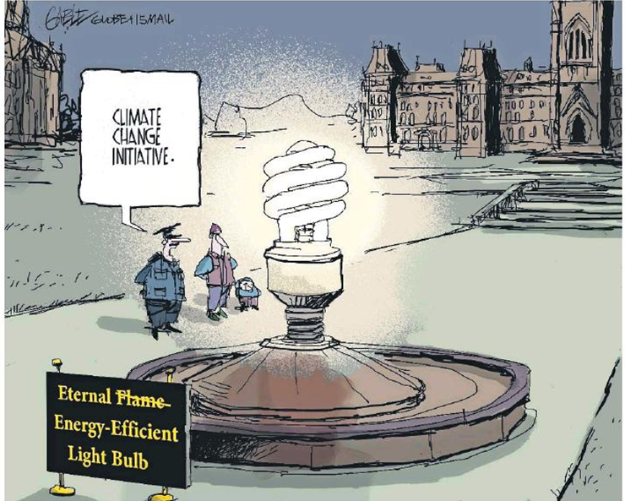
… Includes A Greener And More Costly Future

Slide 53
Global Forecasts
Forecasts as of October 17th, 2016.

Slide 54
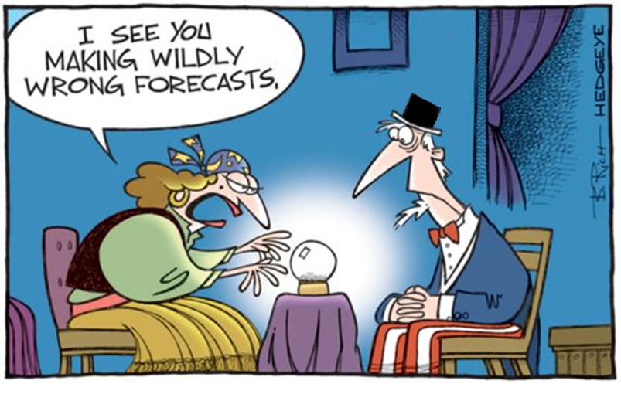
A Complex World Is Challenging Forecasters

Slide 55
Disclaimer
This report has been prepared by Scotiabank Economics as a resource for the clients of Scotiabank. Opinions, estimates and projections contained herein are our own as of the date hereof and are subject to change without notice. The information and opinions contained herein have been compiled or arrived at from sources believed reliable but no representation or warranty, express or implied, is made as to their accuracy or completeness. Neither Scotiabank nor any of its officers, directors, partners, employees or affiliates accepts any liability whatsoever for any direct or consequential loss arising from any use of this report or its contents.
These reports are provided to you for informational purposes only. This report is not, and is not constructed as, an offer to sell or solicitation of any offer to buy any financial instrument, nor shall this report be construed as an opinion as to whether you should enter into any swap or trading strategy involving a swap or any other transaction. The information contained in this report is not intended to be, and does not constitute, a recommendation of a swap or trading strategy involving a swap within the meaning of U.S. Commodity Futures Trading Commission Regulation 23.434 and Appendix A thereto. This material is not intended to be individually tailored to your needs or characteristics and should not be viewed as a “call to action” or suggestion that you enter into a swap or trading strategy involving a swap or any other transaction. Scotiabank may engage in transactions in a manner inconsistent with the views discussed this report and may have positions, or be in the process of acquiring or disposing of positions, referred to in this report.
Scotiabank, its affiliates and any of their respective officers, directors and employees may from time to time take positions in currencies, act as managers, co-managers or underwriters of a public offering or act as principals or agents, deal in, own or act as market makers or advisors, brokers or commercial and/or investment bankers in relation to securities or related derivatives. As a result of these actions, Scotiabank may receive remuneration. All Scotiabank products and services are subject to the terms of applicable agreements and local regulations. Officers, directors and employees of Scotiabank and its affiliates may serve as directors of corporations.
Any securities discussed in this report may not be suitable for all investors. Scotiabank recommends that investors independently evaluate any issuer and security discussed in this report, and consult with any advisors they deem necessary prior to making any investment.
This report and all information, opinions and conclusions contained in it are protected by copyright. This information may not be reproduced without the prior express written consent of Scotiabank.
™Trademark of The Bank of Nova Scotia. Used under license, where applicable.
Scotiabank, together with “Global Banking and Markets”, is a marketing name for the global corporate and investment banking and capital markets businesses of The Bank of Nova Scotia and certain of its affiliates in the countries where they operate, including, Scotiabanc Inc.; Citadel Hill Advisors L.L.C.; The Bank of Nova Scotia Trust Company of New York; Scotiabank Europe plc; Scotiabank (Ireland) Limited; Scotiabank Inverlat S.A., Institución de Banca Múltiple, Scotia Inverlat Casa de Bolsa S.A. de C.V., Scotia Inverlat Derivados S.A. de C.V. – all members of the Scotiabank group and authorized users of the Scotiabank mark. The Bank of Nova Scotia is incorporated in Canada with limited liability and is authorised and regulated by the Office of the Superintendent of Financial Institutions Canada. The Bank of Nova Scotia is authorised by the UK Prudential Regulation Authority and is subject to regulation by the UK Financial Conduct Authority and limited regulation by the UK Prudential Regulation Authority. Details about the extent of The Bank of Nova Scotia's regulation by the UK Prudential Regulation Authority are available from us on request. Scotiabank Europe plc is authorised by the UK Prudential Regulation Authority and regulated by the UK Financial Conduct Authority and the UK Prudential Regulation Authority.
Scotiabank Inverlat, S.A., Scotia Inverlat Casa de Bolsa, S.A. de C.V., and Scotia Derivados, S.A. de C.V., are each authorized and regulated by the Mexican financial authorities.
Not all products and services are offered in all jurisdictions. Services described are available in jurisdictions where permitted by law.

