Slide 1
Hardlines Conference
Niagara-On-The-Lake
November 12th 2018

Slide 2
Tell me about a Brand you admire. Why?

Slide 3
Tell me about a Brand you don’t admire. Why?

Slide 4
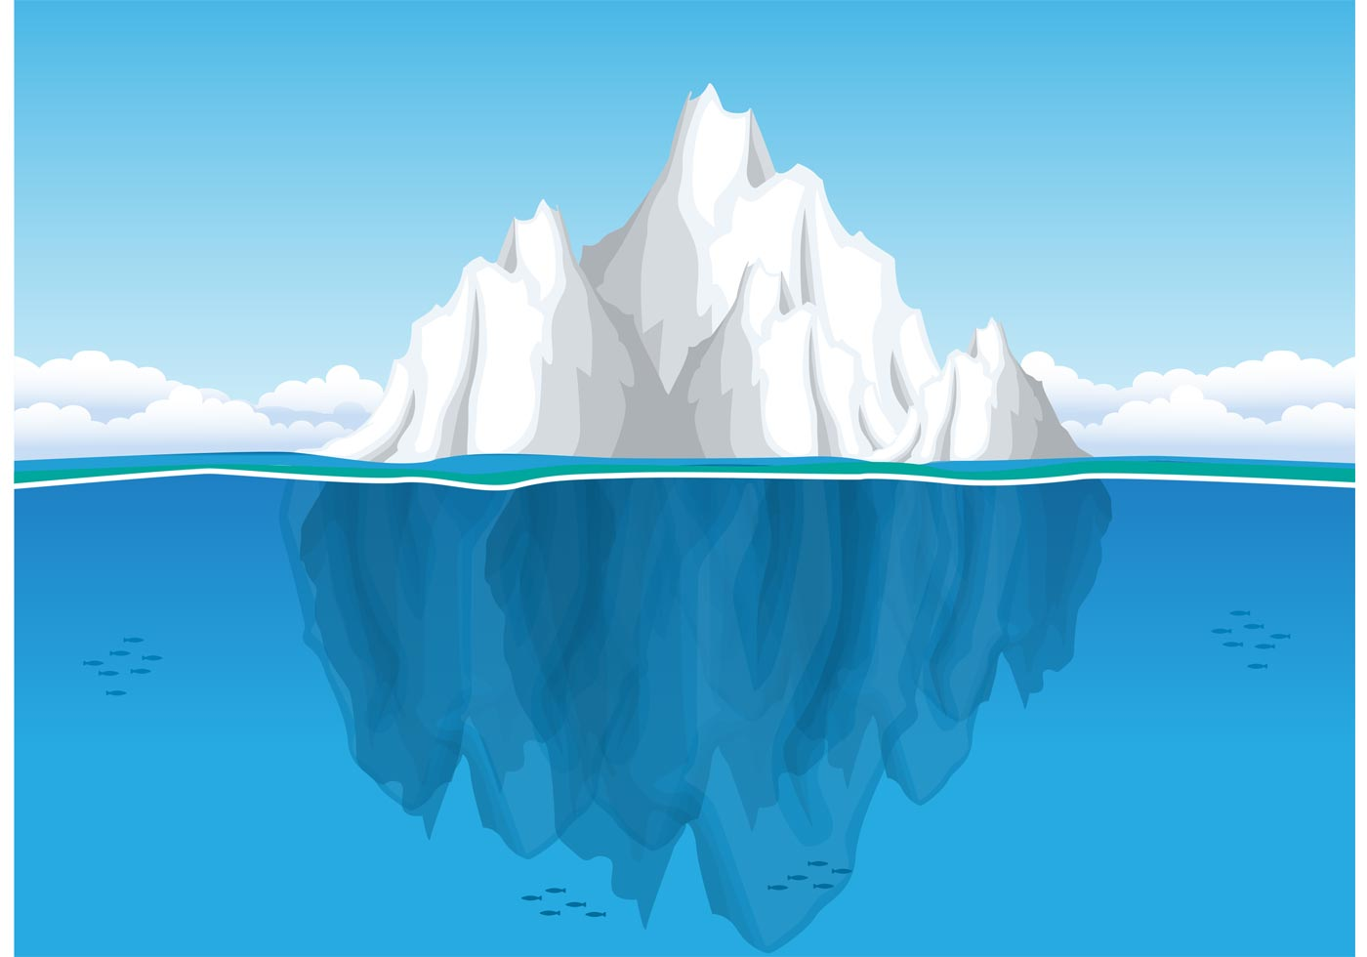
Our Perspective: Your brand is your business system™
Name
PR
Price
Advertising
Logo
Products & Services
Packaging
Sales
Supply Chain
Store
Operations
Recruitment
Customers
IT
Quality Control
Culture
Systems & Structure
HR
Finance
Internal Communications
Employee Training
Knowledge Management
Merchandising
Company Assets
Customer Database

Slide 5
Today….
What is a brand?
Why is it important?
Forces affecting retail brands
Retailers who have leveraged their brand for growth

Slide 6
We define a brand as…
The Value of a Promise Consistently Kept™
Ownable, Competitive Advantage
Inspired Growth
Trusted Partner

Slide 7
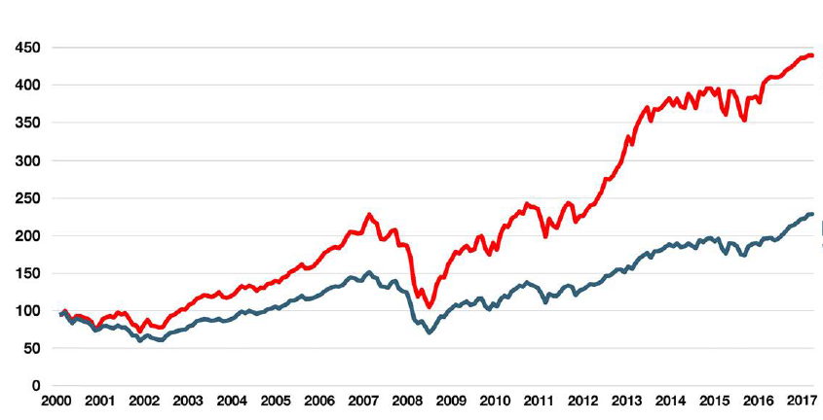
Why you should pay attention to brands…..
Market performance of the top 100 brands compared to the MSCI World Index
Top 100 Brands
MSCI World
Source: Interbrand, Best Global Brands 2017

Slide 8
Branded businesses impact value and reputation…
STAKEHOLDER PERCEPTION
FINANCIAL
IMPACT
SHAREHOLDER
VALUE
Customers | Revenues Risk
Suppliers/Partners | Costs Revenues
Employees | Costs Productivity
Shareholders/Bankers | Costs Risk
Other Stakeholders | Costs Risk
Influences business and brand value
Source: Brand Finance plc

Slide 9
Retail Forces of Change

Slide 10
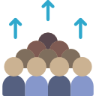
Forces of Change
HEIGHTENED
COMPETITION
DIGITAL
DEMOGRAPHICS
Retail Industry
ECONOMY
CONSUMER
POWER

Slide 11
For retailers, a new organizational model has emerged
Product-centric
Customer-centric
Merchandising
Store Operations
Merchandising
Store Operations
Strategy / Marketing
Supporting
Functions
Supporting
Functions
Customer experience is one of the few levers of differentiation left for Bricks and Mortar

Slide 12
Ask yourself…
How healthy is the market place for your brand? What opportunities can you leverage for your brand?
What is your Brand Vision and your Mission?
How healthy is your business model? Does it support your brand?
Who is your target?
Do you have the right human resources to champion your brand and achieve your vision?
How is your brand differentiating in the marketplace?

Slide 13
Creating a differentiation and bond with your brand requires two things….
Functional Relevance
Emotional Relevance

Slide 14
Functional Relevance
Do you know the functional drivers of purchase decisions in your category/market
What drivers can you/do you own?
What unique set of services or features does a customer get that differentiates you?

Slide 15
Emotional Relevance
Do you know the emotional drivers of purchase intent?
Can or does your brand own any of these drivers?
How are you using them to differentiate?

Slide 16
Why does this matter?
50% of ALL
decisions are made at the
emotional level

Slide 17
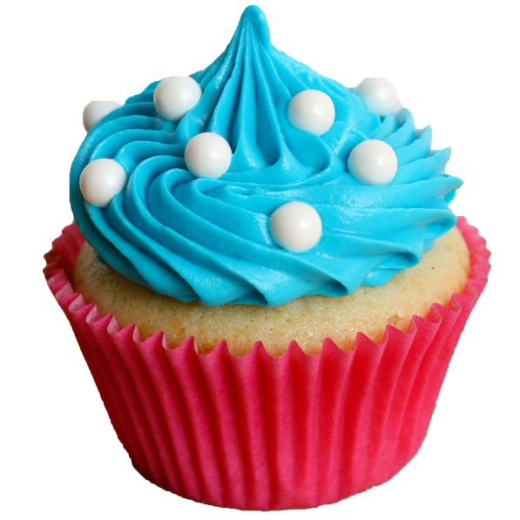
How humans make decisions
3. Rational Mind Kicks In: Approval or Veto? –
No, that’s not a
healthy choice
1. Animal Reaction to External Stimuli – Excited by sight of cupcake
2. Emotional Reaction (Impulse to Act) –
“I Want”
Brands must deliver BOTH emotion (impulse) and rational benefits (approval)

Slide 18
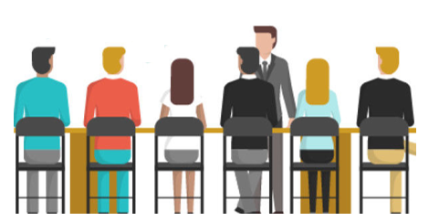
Understanding why people do what they do
Question: Why did you pick the smartphone you purchased?
Traditional market research asks individuals a question and takes their answers at face value.
REAL decision drivers are grounded in emotion. However, individuals seldom articulate these real drivers of their behaviour:
INDIVIDUALS SAY…
INDIVIDUALS FEEL…
Camera Quality
Battery Life
Voice Recognition
All my friends have the same phone
Makes me feel cool & trendy
Shows that I am successful
Durability
Operating System
I want to fit in
It makes me look tech savvy
Security Features

Slide 19
Today….
What is a brand?
Why is it important?
Forces affecting retail brands
Retailers who have leveraged their brand for growth

Slide 20
Leveraging the Brand to succeed in the market…..
Be Bold
Be True
Be New

Slide 21
The Situation
RH opened in 1979 as a source for old house restorers
By 1990’s had evolved to a housewares store selling objects with nostalgic narratives
By 2001 it was floundering and almost bankrupt. A new CEO was brought in and overhauled the product and merchandising to big furniture reflective of some of the world’s top interior designers
2012 company went public and “rebranded” as RH

Slide 22
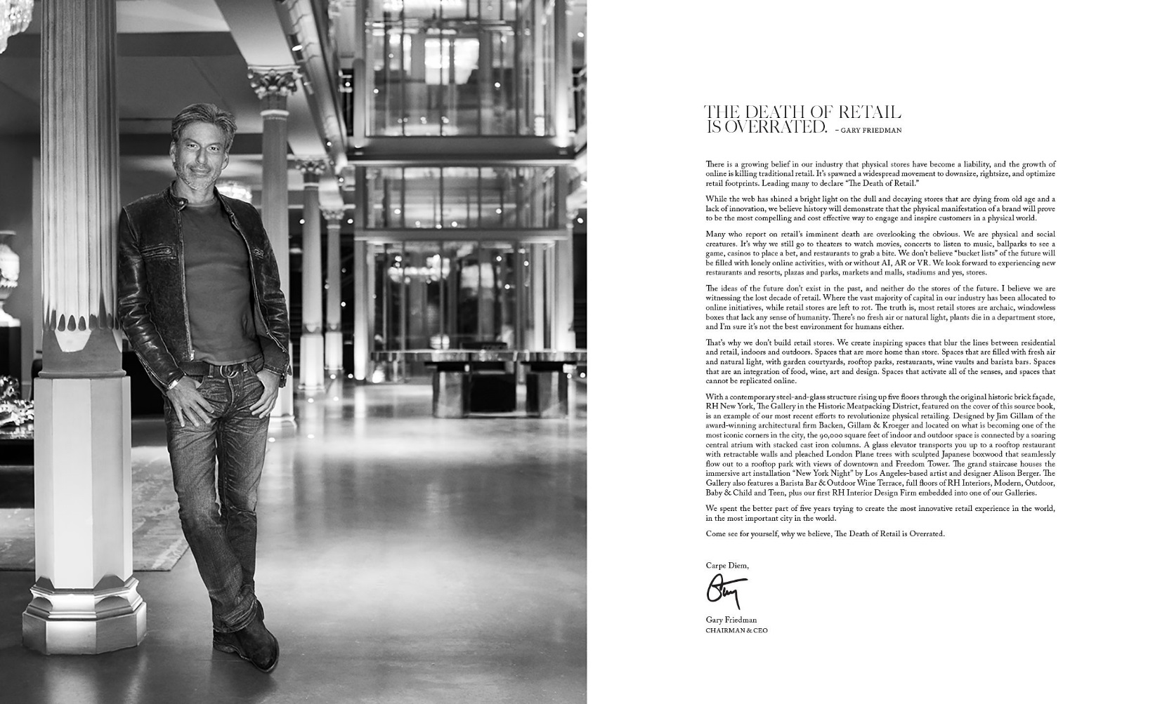
What did they do with the brand? Be Bold.
Restoration Hardware carried out a complete transformation…high risk, high reward
They articulated a bold Vision…
A message from their CEO…
“…we believe history will demonstrate that the physical manifestation of a brand will prove to be the most compelling and cost effective way to engage and inspire consumers in a physical world.”
“That’s why we don’t build retail stores. We create inspiring spaces that blur the lines between residential and retail, indoors and outdoors. Spaces that are more home than store.”

Slide 23
What did they do with the brand? Be Bold.
Restoration Hardware carried out a complete transformation…high risk, high reward
..they better understood their target market...
Restoration Hardware focused on more upscale clients – households with higher incomes and built an experience that catered to them…
Premium products
New brands – RH Modern, RH Teen, RH Baby & Child
Interior design consultations
And more…
Source: Financial Times
Notes:
https://www.ft.com/content/34e6b37e-5cb5-11e5-a28b-50226830d644

Slide 24
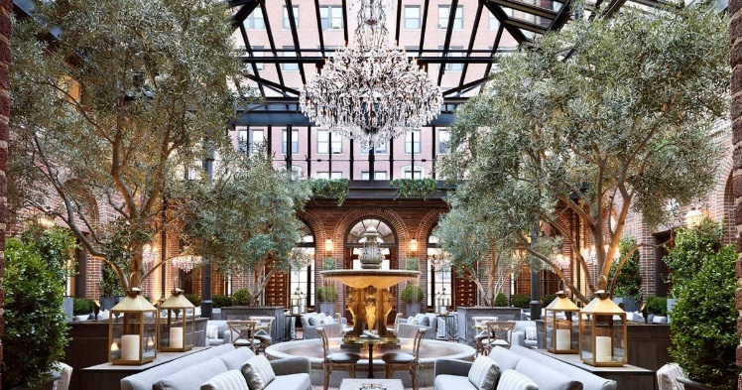
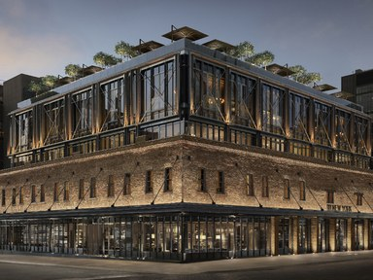
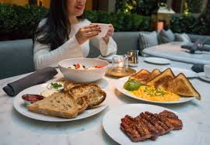
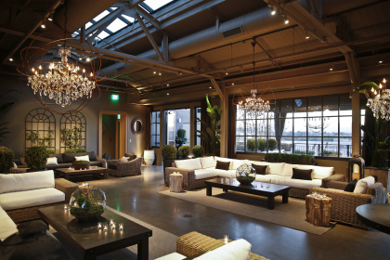
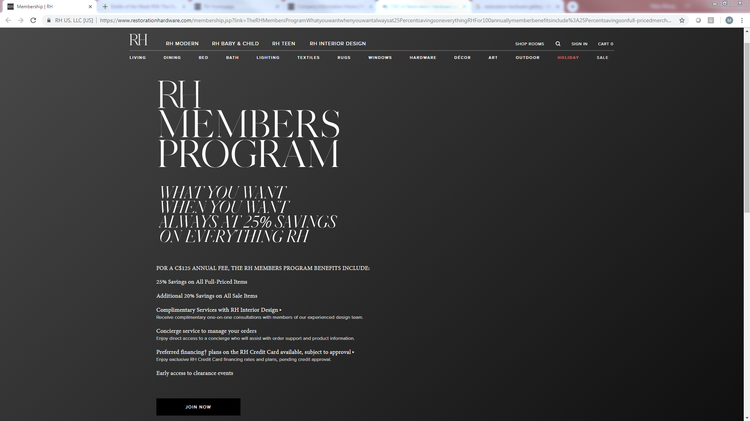
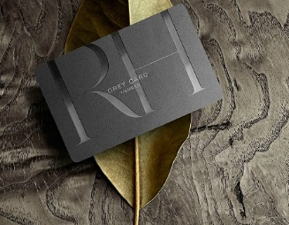
What did they do with the brand? Be Bold.
Restoration Hardware carried out a complete transformation…high risk, high reward
…and overhauled their business model
HOSPITATILITY
‘DESIGN GALLERIES’
MEMBERSHIP MODEL

Slide 25
The Result
Annual Net Sales Revenue (Unit: Million USD)
5-yr CAGR: 15%
Since 2013, RH’s annual net revenue has doubled from ~1.2 billion USD to ~2.4 billion USD with a 6-yr CAGR of ~15%. Stock price has more than tripled from $35/share in 2013 to $116/share today.
Source: Market Watch
Notes:
https://www.ft.com/content/34e6b37e-5cb5-11e5-a28b-50226830d644

Slide 26
The Situation
Canadian Tire was founded in Hamilton by the Billes brothers in 1922
Canadian Tire grew – by 1997, 85% of the population lived within a 15-minute drive of a Canadian Tire store
One of Canada’s best known brands - 9 out of 10 Canadians shop at Canadian Tire
By 2007, Canadian Tire had begun facing intense competitive pressure and its reputation was showing some tarnish – “Crappy Tire”
2010 leadership embarks on a new strategy

Slide 27
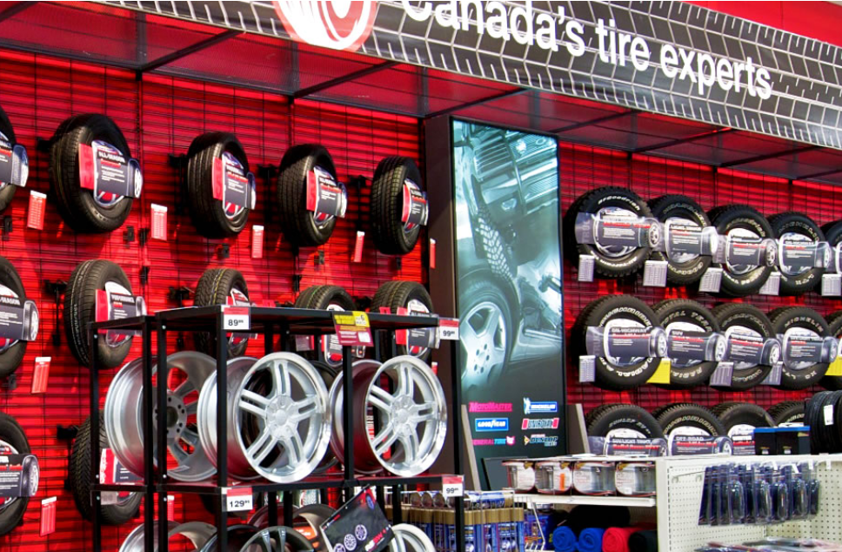
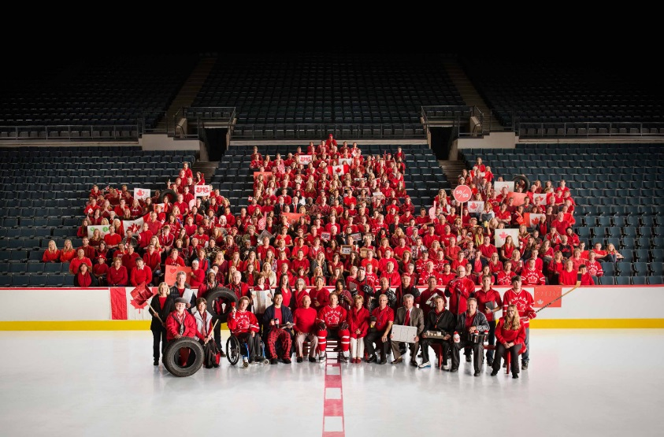
What did they do with the brand? Be True
They went back to their roots – Automotive Authortiy and Canada’s store for the Job and Joys of life – re-energizing the brand with a clear vision and mission…
…They doubled down on the brand as the driving force for change by understanding the emotional and functional drivers they owned and tapping into the deep emotional well Canadians have for the brand…

Slide 28
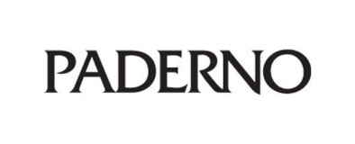
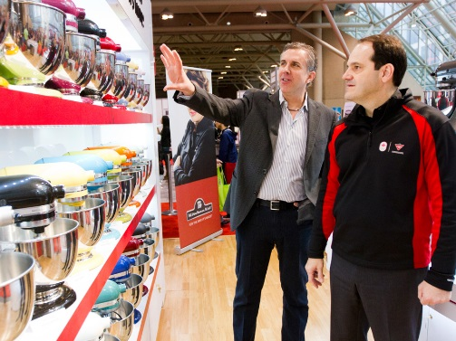
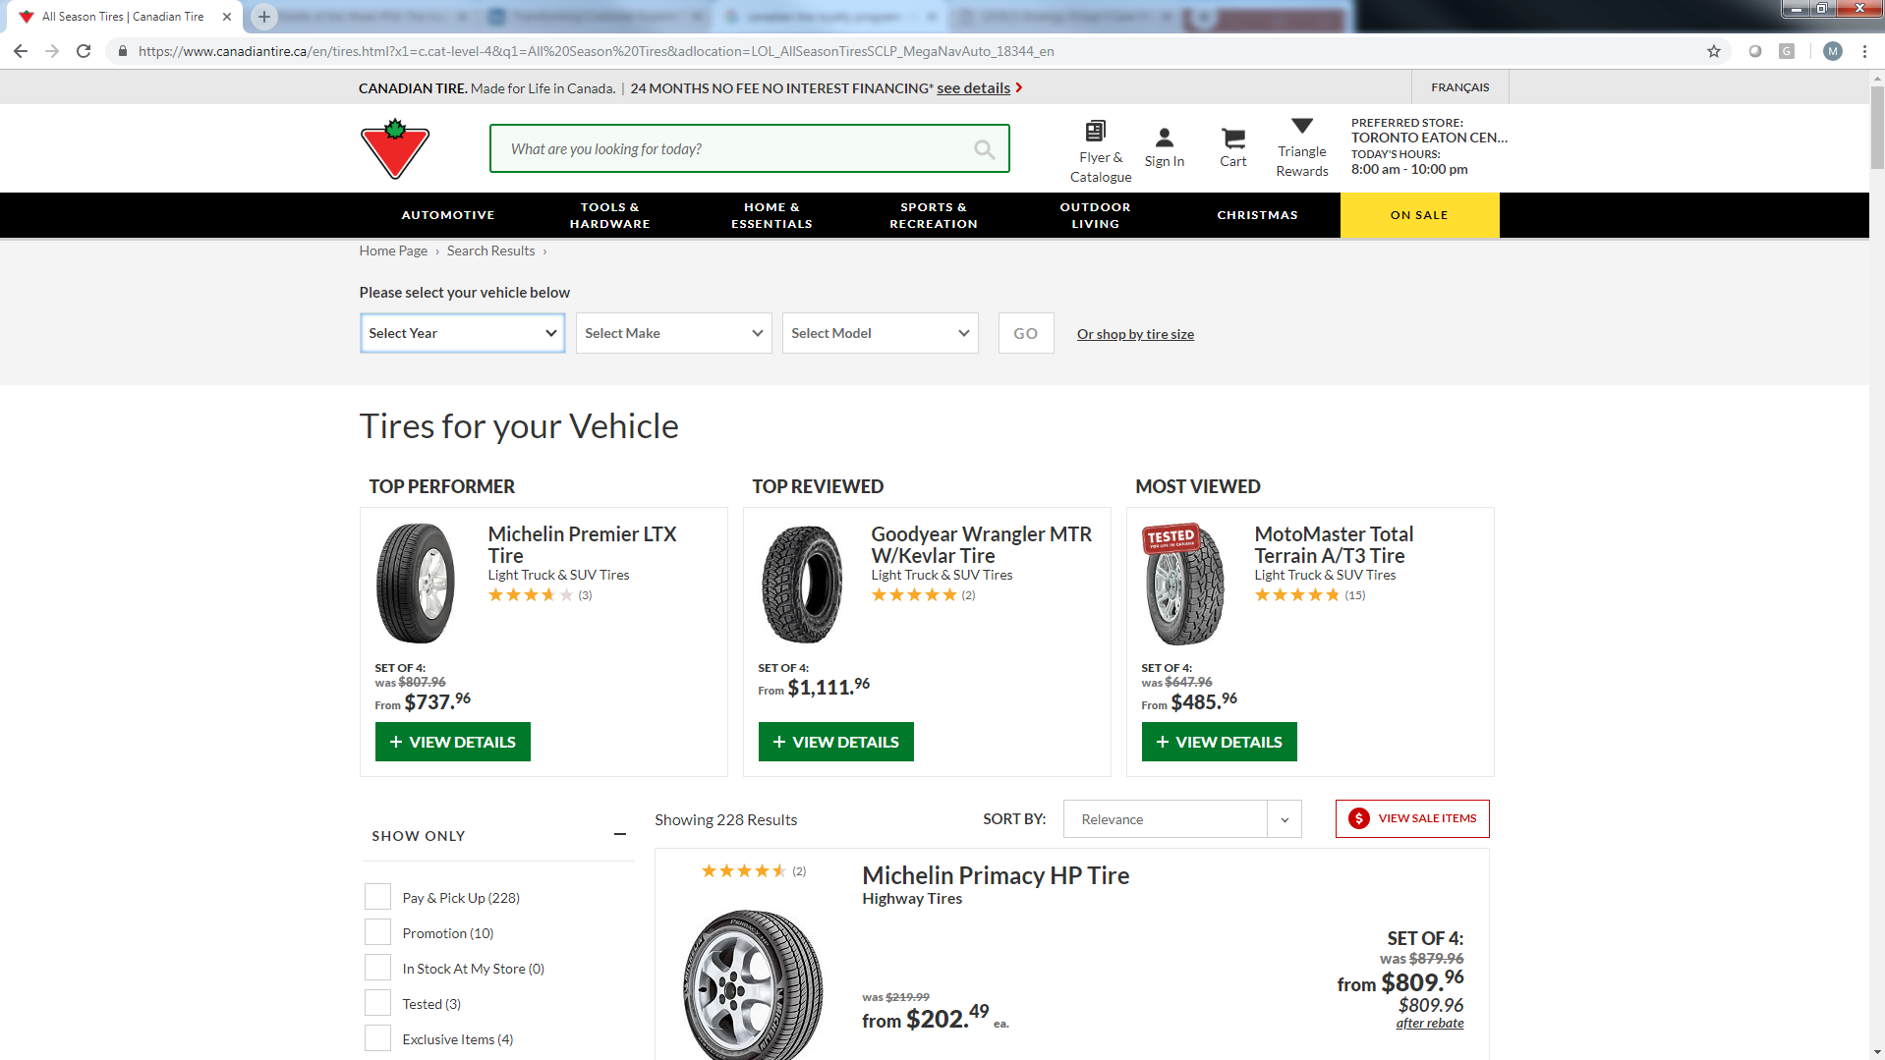
What did they do with the brand? Be True
They better understood their customers to improve the customer experience by:
Strengthening its own brand portfolio
Focus on quality of products – tested in Canada
Having a clear focus on the target and understanding them
Becoming an e-commerce force (again)
Updating its loyalty program
Adapting its business model to provide a better experience to customers and Dealers

Slide 29
The Result
In the 1990s, Canadian Tire stock price remained consistent in the $40-$50/ share. In the last 10 years, the stock price has steadily risen from $50/ share to $233/ share!
Canadian Tire has maintained a strong brand reputation in the market; it is consistently ranked in top category of Canadian brands and highly in North America for performance
Canadian Tire’s revenue has consistently either matched or beat the market

Slide 30
The Situation
In 1997, Apple launched its online store
Dissatisfied with its channel partners, Apple launched their own retail store in 2001
The focus was on customer experience:
A – approach customers with a personalised warm welcome
P – probe politely to understand needs
P – present solution to take home today
L – listen for and resolve issues or concerns
E – end with fond farewell and invitation to return
Today – there are 505 Apple stores in 24 countries
Retail is Apple’s largest product – over 500 million people visit each year!

Slide 31
What did they do with Brand? Be New
Apple’s Brand DNA
Apple revolutionised retail!
Design
Merchandising
Hiring and Training
Transaction
Exceptional Customer Experience - “Enrich Lives”
Personality
Organization
Cool
Passionate
Defiant
Visionary
Friendly
Disciplined
Simplicity by Design
Products/ Services
Relationships
Intuitive-Easy
Genuine
Personal
Controlling
Controlled
(Apple System)
Enduring

Slide 32
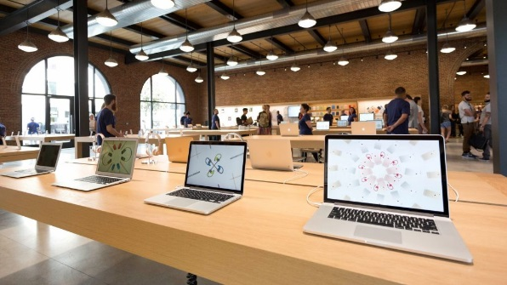
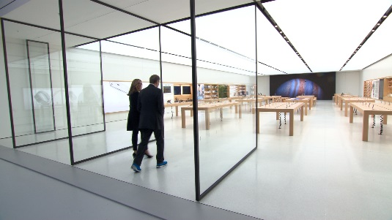
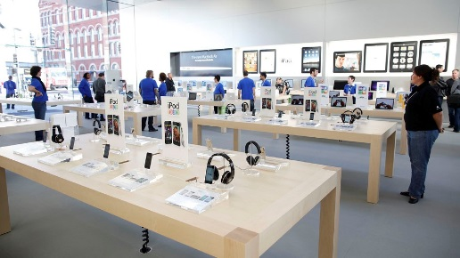
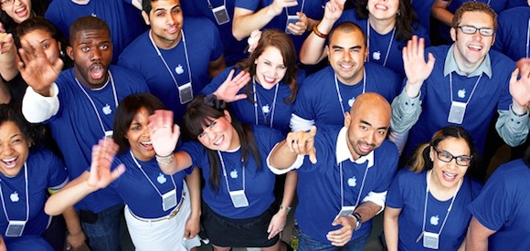
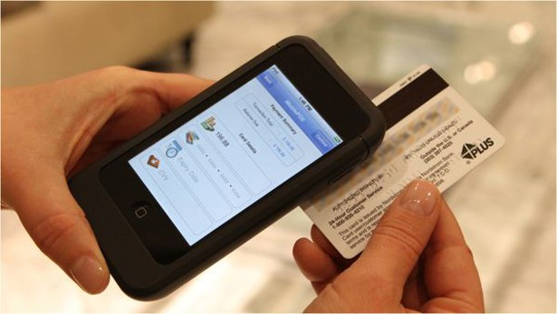
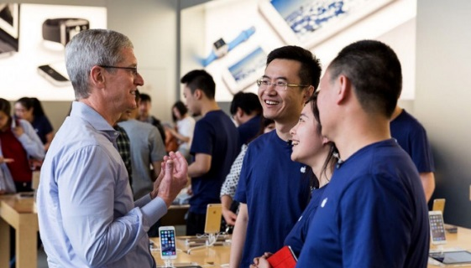
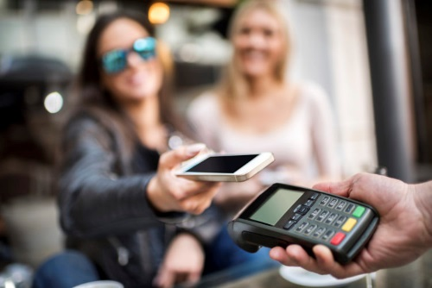
What did they do with Brand? Be New
Staying true to their Brand DNA, Apple revolutionized retail and created an exceptional customer experience that ‘enriched lives’
DESIGN
MERCHANDISING
HIRING & TRAINING
TRANSACTIONS

Slide 33
The Results
Apple continues to be a top retailer in sales per square foot - $5,546/ sqft.
Apple continues to evolve while staying true to their brand DNA – for example, there are no longer stores, but rather town squares where on third of the space devoted to “Today at Apple” – once again, Enriching Lives!

Slide 34
In Summary
Your Brand is Your Business System
Brand = Value of a Promise Consistently Kept
To unleash your brand to drive growth:
Be Bold
Be True
Be New

Slide 35
Thank You
Q&A

Slide 36
This report is solely for the use of client personnel. No part of it may be
circulated, quoted, or reproduced for distribution outside the client organization without prior written approval from LEVEL5 Strategy Group™.
© LEVEL5 Strategy Group™ 2018

