Slide 1
BUILDING THE
FUTURE
MICHELLE CHOUINARD KENNEY

Slide 2
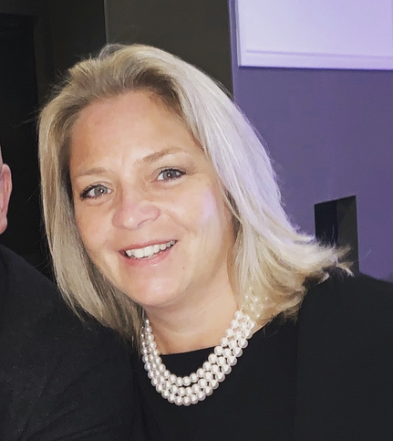
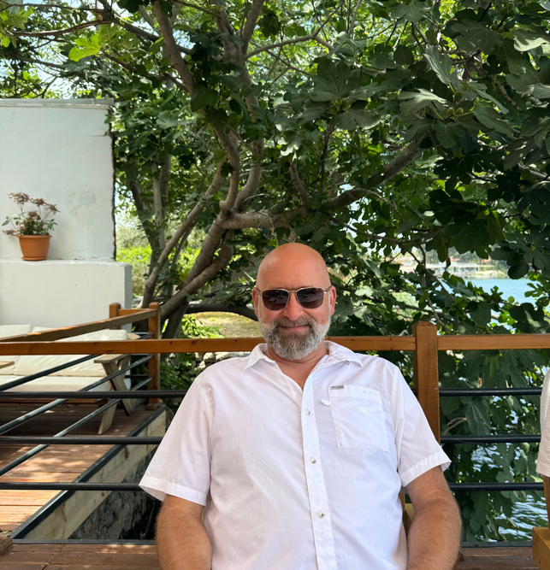
ABOUT US
Cathy Chouinard
Lucien Chouinard
Michelle Chouinard Kenney
Owner
Owner
CEO
Bryan Kenney
Max Kenney
Owen Kenney
The Chouinard Family
Director Of Operations
Gibson
Flat Roof Manager
Facilities Manager

Slide 3
ABOUT US: OVERVIEW
Our Companies
Founded in 1972 from the back of a truck, Chouinard Bros Roofing has transformed into a premier leader in Ontario’s new build construction sector, renowned for its commitment to quality and innovation.
Established in 1999, Gibson Building Supplies has grown into a major distributor of building materials across Ontario, serving the industry with a robust selection and exceptional service for over 25 years.
Chouinard Bros
Gibson Building Supplies
With over 40 years of experience in the industry, Best Distribution Supplies offers a comprehensive one-stop shop for a wide range of products from various suppliers, ensuring quality and convenience for all your building needs.
Since its founding in 2008, Capstone has been a trusted supplier of building products to Atlantic Canada, delivering quality materials and exceptional service to the region's construction industry.
Best Distribution
Capstone Building Products

Slide 4
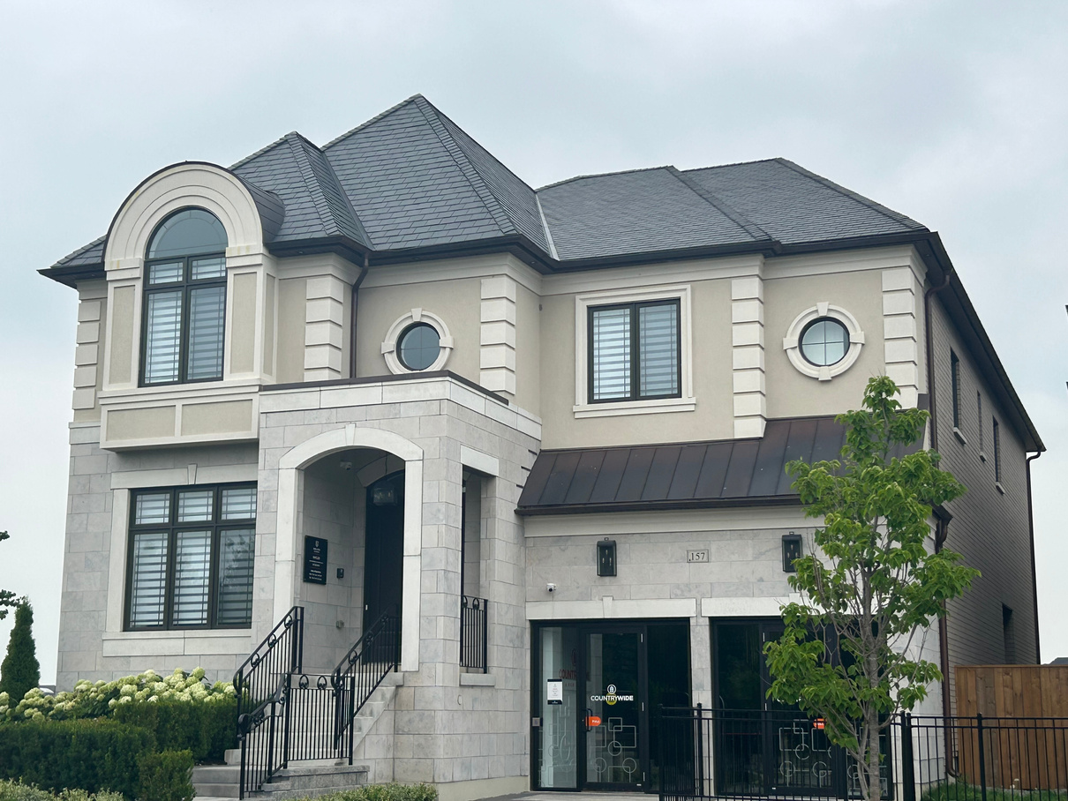
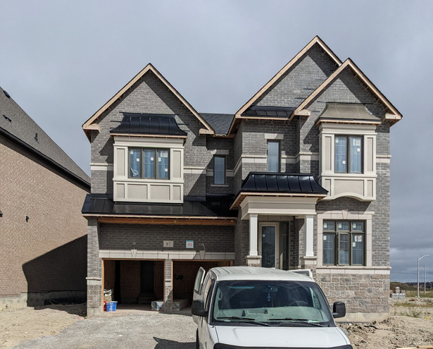
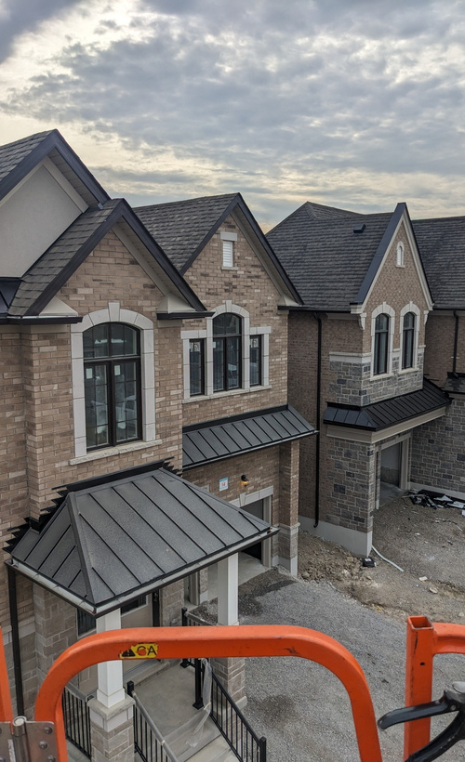
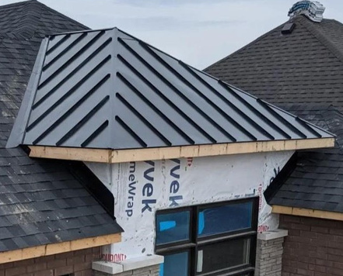
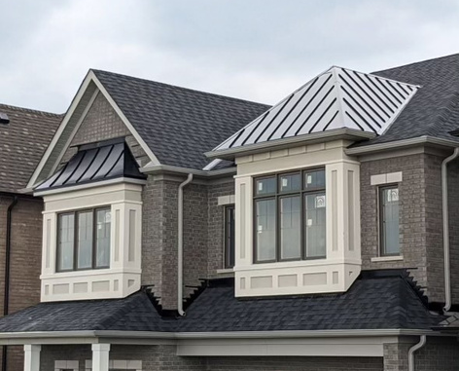
CHOUINARD BROS
As a proud family-owned business, Chouinard Bros Roofing has built a reputation for quality and reliability over the past five decades. We specialize in commercial new construction and have partnered with some of Canada’s largest builders, including Tribute, Mattamy, and The Greenpark Group.

Slide 5
CHOUINARD BROS
TIMELINE
Transition to New Construction
Expanded Siding Department
Began working in new home construction with key builders: Tribute, Greenpark, Great Gulf, Mattamy, and Brookfield.
Expanded the aluminum and siding department to include a broader range of roofing components.
1972
1985
1999
2014
2024
Chouinard Bros Founded
Opened Distribution To Support Chouinard
Continuing Expansion
The Chouinard brothers founded Chouinard Brothers Incorporated out of the back of a pickup truck.
Continued expansion throughout Southern Ontario, developing and streamlining effective operational strategies for each region.
Founded Gibson Building Supplies to support Chouinard Brothers Incorporated.

Slide 6
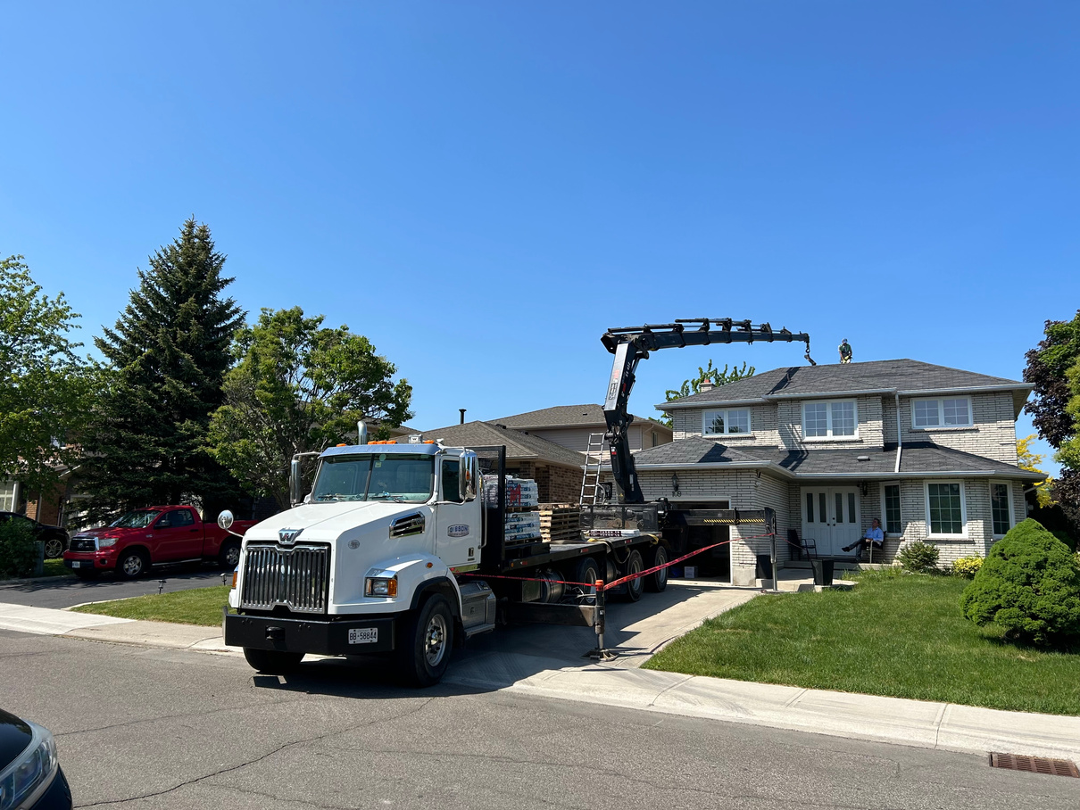
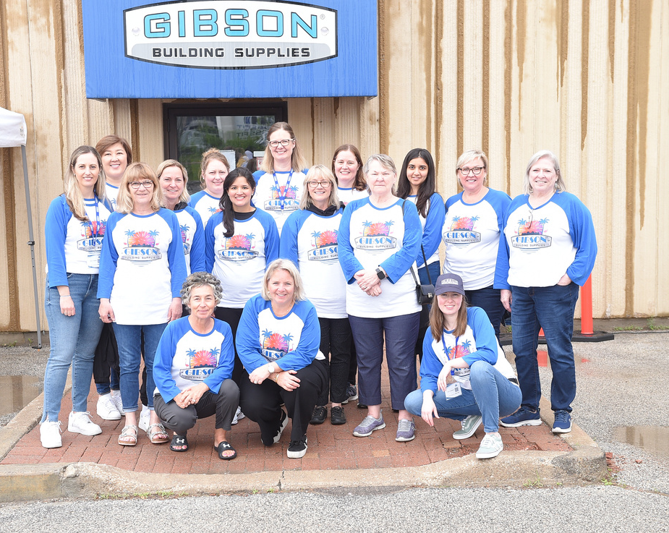
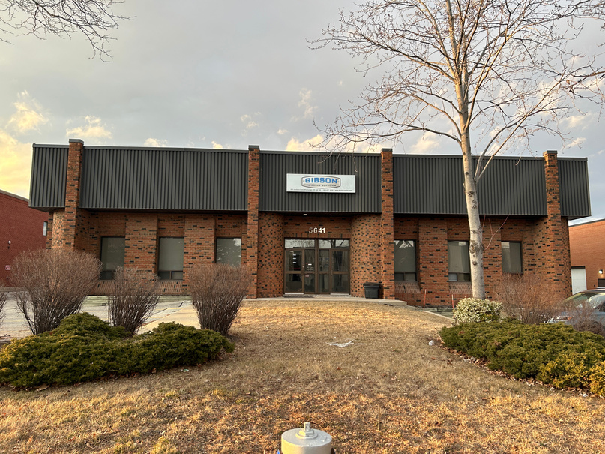
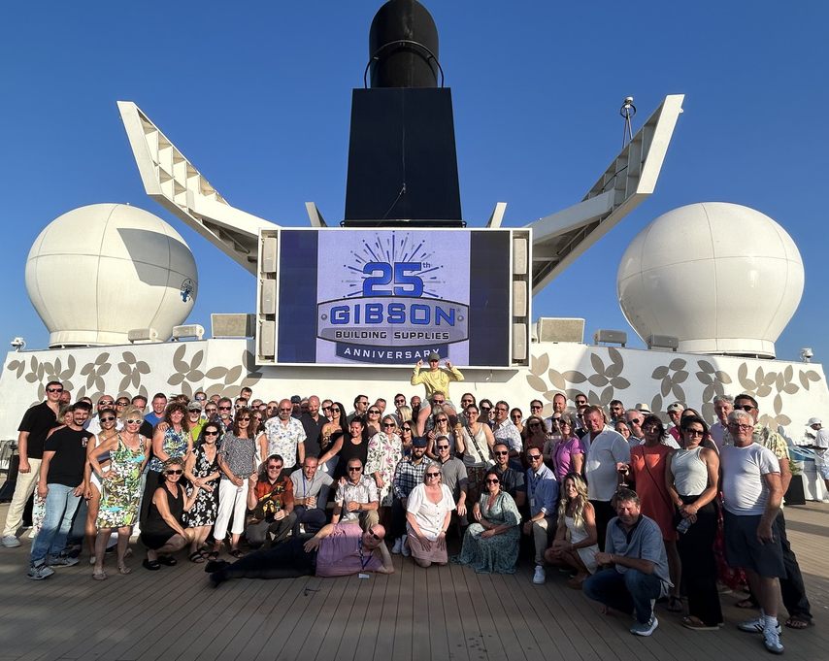
GIBSON
We are an independently-owned Canadian company providing you with a large selection of quality roofing and exterior building supplies from leading manufacturers.
Our highly trained, local experts take personal pride in bringing you the best quality and service in the industry.

Slide 7
GIBSON TIMELINE

Slide 8
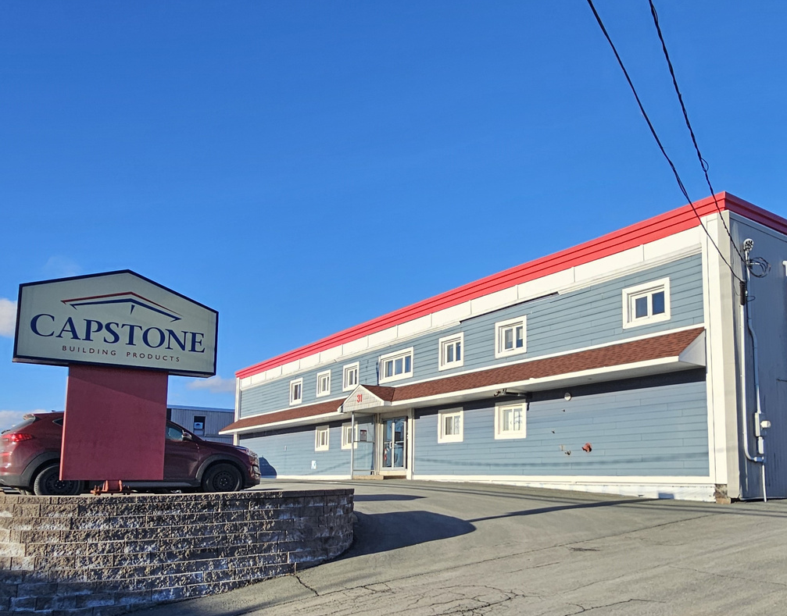
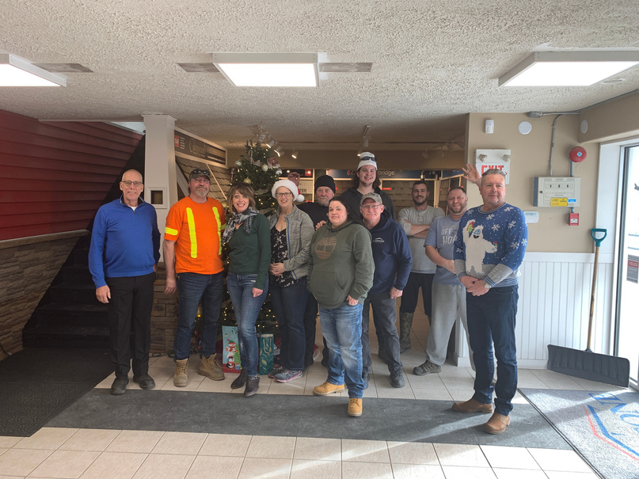
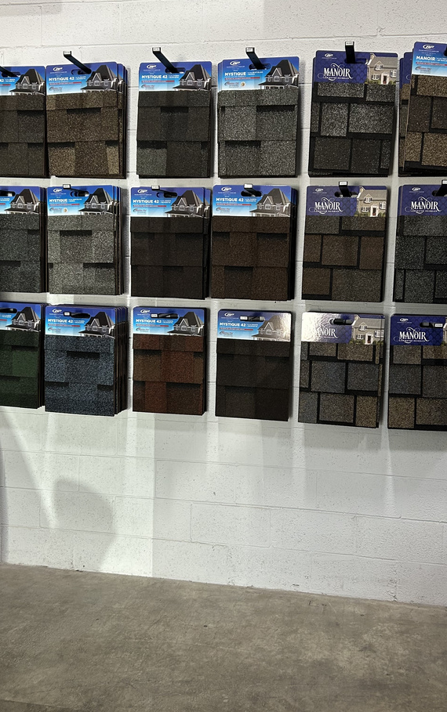
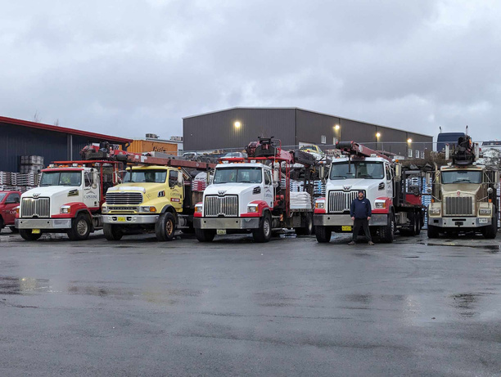
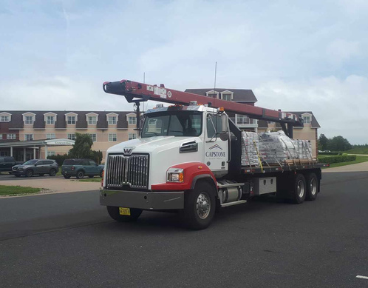
CAPSTONE
Since 2008, Capstone Building Products has been a trusted provider of building supplies to Atlantic Canada, delivering quality materials with a commitment to customer care. With a focus on reliability and efficiency, Capstone continues to support the growth and development of the region’s construction industry.

Slide 9
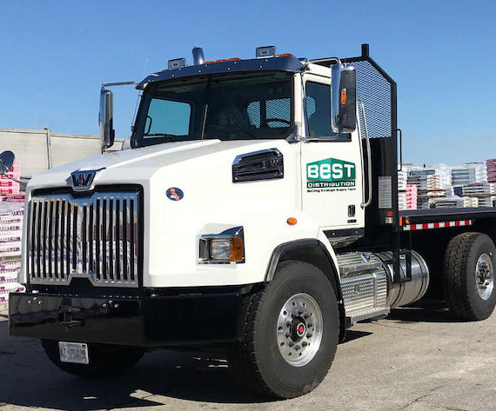
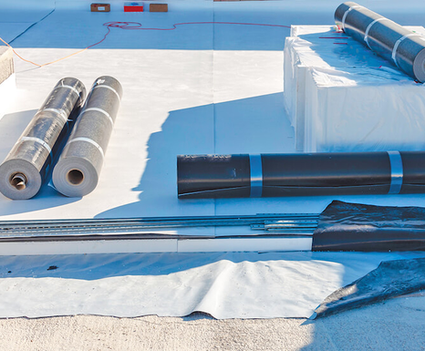
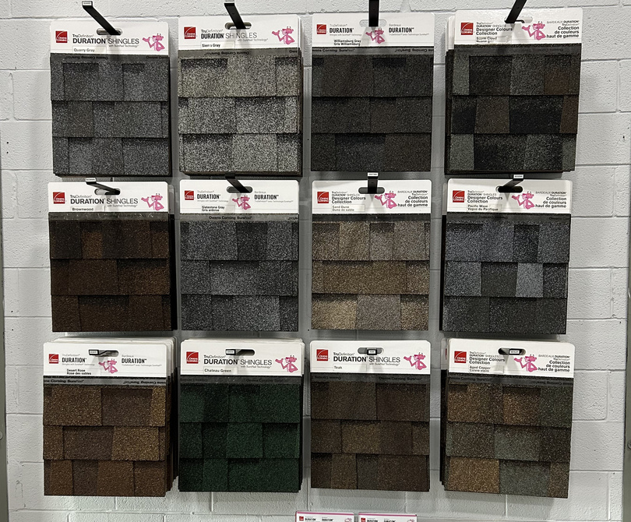
BEST DISTRIBUTION
With over 40 years of experience in the industry, Best Distribution is dedicated to providing a comprehensive selection of roofing and building materials. Our flexible ordering process allows customers to choose from a wide variety of products from multiple suppliers, ensuring you get exactly what you need.

Slide 10
CHALLENGES & BENEFITS OF OPERATING FAMILY BUSINESS
CHALLENGES & BENEFITS OF OPERATING FAMILY BUSINESS
STAKEHOLDER
As stakeholders in your success, our commitment goes beyond delivering exceptional services; we prioritize understanding and aligning with the unique goals and values of our clients.
Challenges | Benefits
Defining Roles | Flexibility
Succession Planning | Drive In Same Direction
Separating Work/Home | Trust In Working With Family

Slide 11
STAKEHOLDER
As stakeholders in your success, our commitment goes beyond delivering exceptional services; we prioritize understanding and aligning with the unique goals and values of our clients.
OUR INDUSTRIES
What We Do | Steep Slope Roofing | Commerical Flat Roofing | Exterior Cladding

Slide 12
LOOKING TO THE FUTURE
Decrease In Workers
FUTURE CHALLENGES IN THE CONSTRUCTION INDUSTRY
Lack Of Training
Increased Difficulty of Jobs

Slide 13
01
Construction Work Force
The average age of Ontario’s construction workforce = 41 years by 2027
20% of the current workforce will be lost by 2027 due to retirement (BuildForce Canada)
02
Construction Owners
Construction owners tended to be younger than other business owners. About 35% of construction owners were under age 45, compared to 33% of all business owners. More than 40% of all business owners were 55 years or older, in contrast with 35% for construction owners. (Center For Construction Research and Training)
DECREASING WORKERS
03
Challenges of Business Succession
30% of family businesses survive the transition from first to second generation ownership.
12% survive the transition from second to third generation.
3% survive the transition from third generation
Only 13 percent of family businesses remain in the family over 60 years.
And 47% of family business owners expecting to retire in five years DO NOT have a successor (Aronoff, 2017)

Slide 14
DECREASING WORKERS GRAPHS

Slide 15
01
Training Is Essential For Productivity
U.S. contractors wasted between $30 billion and $40 billion in 2022 due to labor inefficiencies, and it appears to be getting worse, according to a new survey from FMI Corp.
The report describes labor as “the largest, riskiest, yet most controllable variable cost” in construction.
The report emphasizes construction’s already thin labor margins, and respondents estimated the industry could have saved $25 billion of the wasted funds with improved management practices. (Philips, 2022)
LACK OF TRAINING
02
Budget For Training
The Apprenticeship Service will provide $470 million over three years, beginning in the 2021 to 2022 fiscal year, to help first-year apprentices in eligible Red Seal trades connect with employment opportunities at small and medium-sized enterprises, giving them the hands-on experience that is required to succeed in the skilled trades. (Government of Canada, 2022)
03
Widening The Gap
The lack of funding for non-red seal trades presents significant adversities, hindering their growth opportunities.
This may oversaturate the Red Seal Trades with workers

Slide 16
DECREASING WORKERS GRAPHS

Slide 17
INCREASED DIFFICULTY OF JOBS
1980s House
House Today

Slide 18
LOOKING TO THE FUTURE
Women In Construction
Developing Union Training Programs
LOOKING INTO THE FUTURE
Professionalization
Develop Exceptional Leaders

Slide 19
WOMEN IN CONSTRUCTION
Problem
Importance
Catalytic Effect
Increasing female participation can help fill gaps and meet growing demand of labor Shortages
Women in these fields serve as role models, inspiring young girls to pursue careers in trades
Half the population but less than 3 percent of work force
BuildForce

Slide 20
DEVELOPING UNION TRAINING PROGRAMS
Training Program Overview
Safety Training Focus
Collaboration: RSCA and Local 27 agreed on the need for a training program to support the construction industry with qualified installers.
Participants: Approximately 150 students have completed various training programs.
Retention Rate: About 70% retention rate among students.
Safety First: All courses prioritize safety.
Safety Training Includes:
WAH (Working at Heights)
WHMIS
Aerial Training
Course Evolution
Future Goals and Acknowledgments
Initial Course: 4-week program with cash incentives.
Incentives: Evolved from monetary and tool incentives to no incentives required.
Current Duration: Expanded to 9 weeks, covering:
Installation of aluminum and vinyl
Specialty products (fiber cement siding, engineered wood, PVC composites), Weather barriers/rainscreening
Blueprint reading
Job readiness guidelines
Goal: Develop a 3-year apprenticeship program encompassing all necessary skills for exterior cladding installation according to manufacturer specifications.
Credits:
Local 27: Pat Bono, Max Mazzotta, Rick Baric, Eduart Dhuza
RSCA: Chouinard Bros - Joe Baric, Giancola - John Giancola
Various Trainers: Paul Burke, Andrew Budhoo

Slide 21
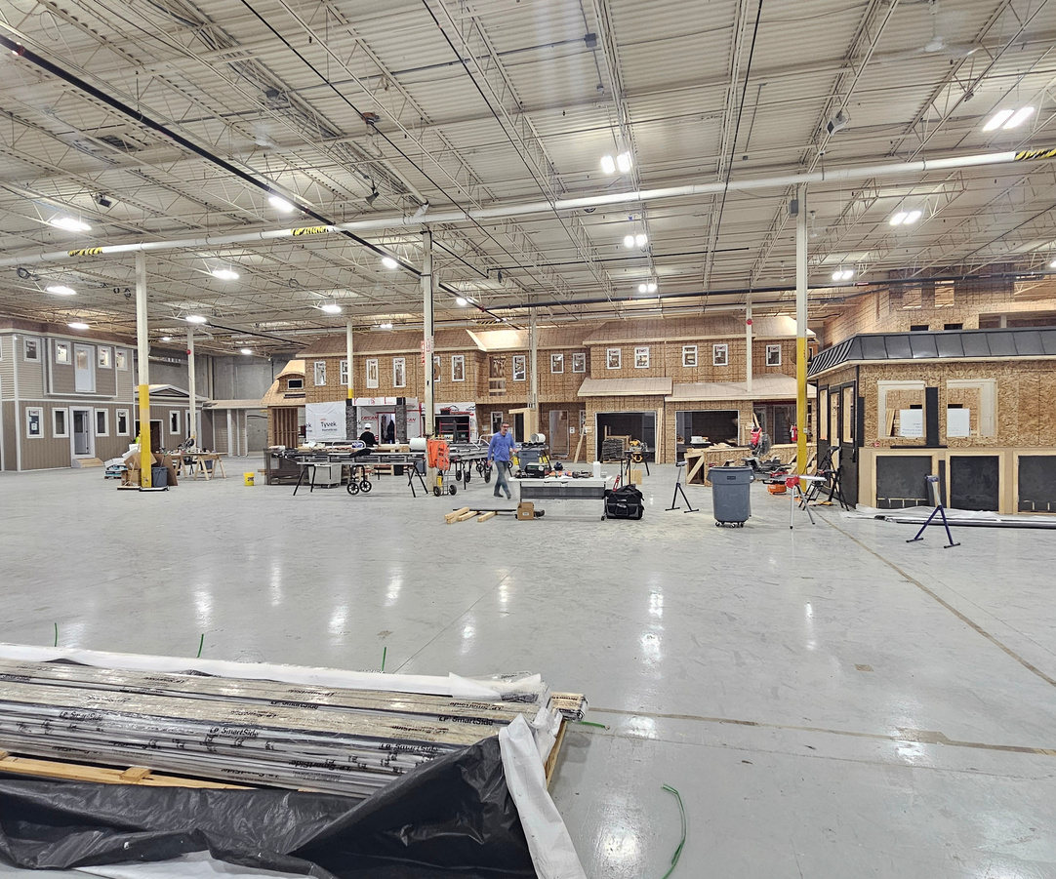
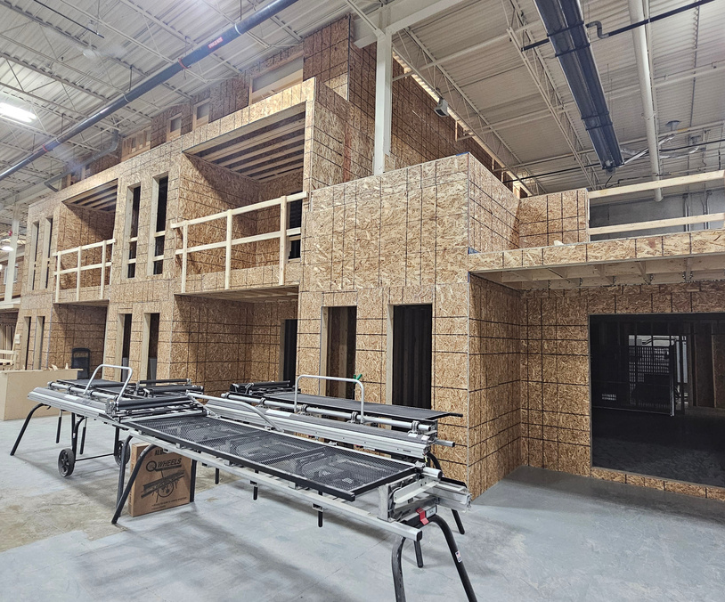
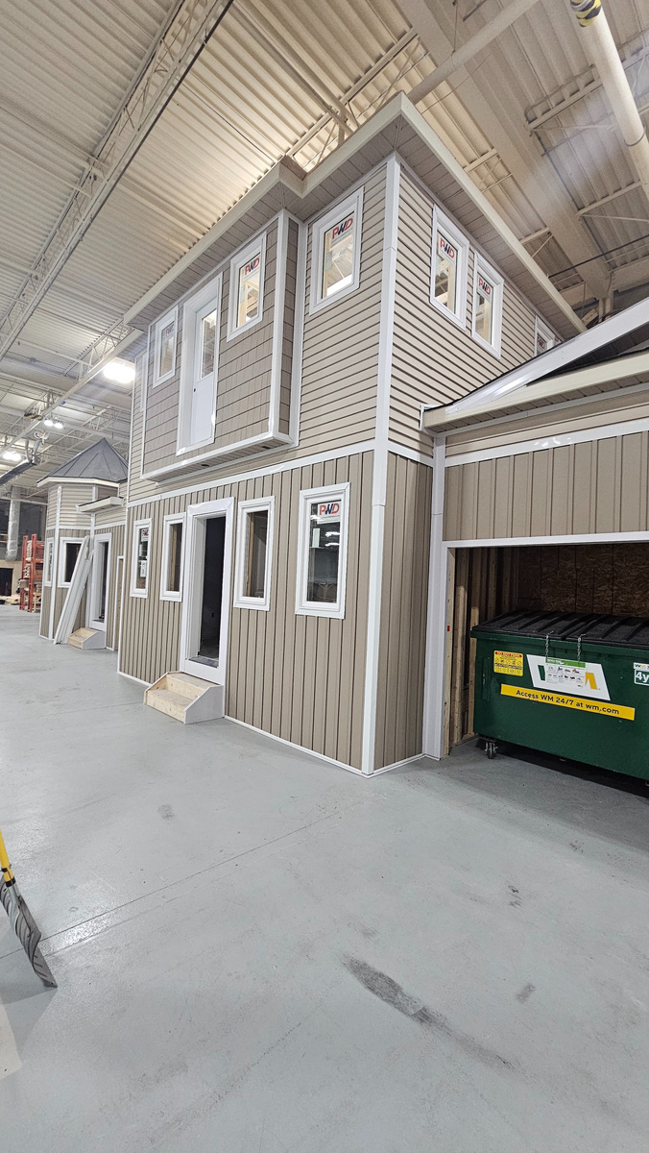
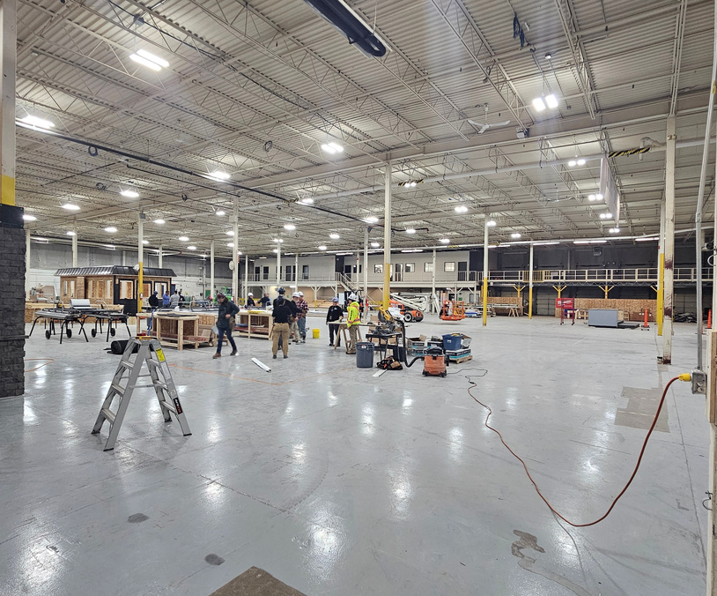
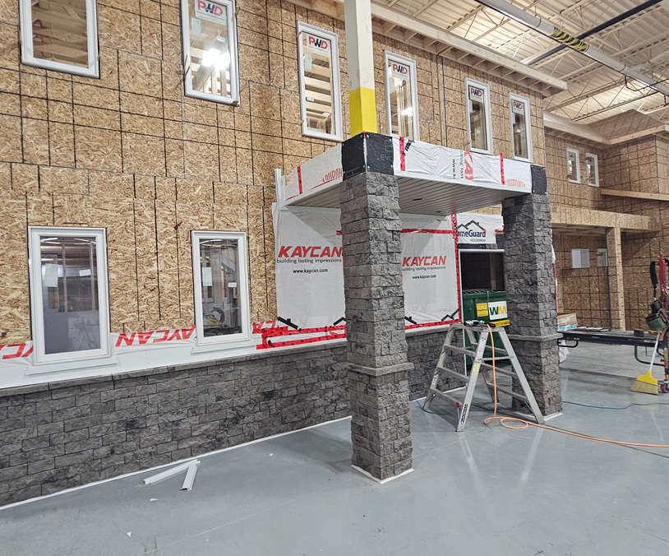
UBC TRAINING
PICTURES

Slide 22
LOOKING TO THE FUTURE
Permit System
PROFESSIONALIZATION
Accreditation
Red Seal Training

Slide 23
DEVELOP EXCEPTIONAL LEADERS
Why Leadership in Construction is Key
Programs
Effective Communication: Leaders ensure clear communication of project goals and safety protocols.
Strategic Decision-Making: They make informed decisions that align with project success.
Mentorship: Leaders foster skills development, creating a pipeline of future talent.
Bachelor of Business Administration (Trades Management) | George Brown College
Trades Management — Bachelor of Business Administration degree - University of the Fraser Valley (UFV)
Bachelor of Business Administrations program |Mohawk College

Slide 24
CLOSING REMARKS

Slide 25
REFERENCES
Aronoff, Craig, (Retrieved June 1, 2017). Family Business Survival: Understanding the Statistics. Family Business Consulting Group, https://www.thefbcg.com/resource/family-business-survival-understanding-the-statistics/
BuildForce, C. (2018, January). Construction and Maintenance Looking Forward, 2018-2027, Highlights, Ontario. https://www.constructionforecasts.ca/sites/forecast/files/highlights/2018/2018_ON_Constr_Maint_Looking_Forward.pdf
Government of Canada. (2022, January). Government of Canada investments in the skilled trades. https://www.canada.ca/en/employment-social-development/news/2022/01/government-of-canada-investments-in-the-skilled-trades.html
IKO. (2023, September 28). Women in the roofing industry: Statistics, Support & Achievement - Iko. IKO Content Hub. https://www.iko.com/blog/how-women-are-helping-to-advance-the-roofing-profession/#:~:text=Women%20make%20up%20only%200.5,that%20benefit%20the%20whole%20industry.
Simpson, T. (2021, June 5). CPWR chart book (6th edition): Industry summary - demographics of business owners in construction and all industries. CPWR. https://www.cpwr.com/research/data-center/the-construction-chart-book/chart-book-6th-edition-industry-summary-demographics-of-business-owners-in-construction-and-all-industries/
Phillips, Z. (2023, October 12). Construction lost as much as $40B on poor productivity in 2022. Construction Dive. https://www.constructiondive.com/news/construction-wastes-billions-labor-lean-planning/696421/

