Slide 1
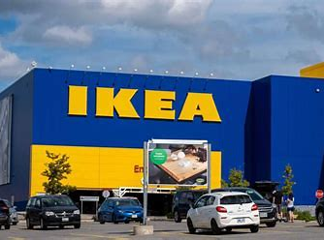
Creating positive change for people and planet
Heléne Loberg, Head of Sustainability, IKEA Canada
October 23, 2024
Notes:
”Among all the challenges that we are confronted by as humankind this decade and the decades to come, climate change and our need to become more sustainable are highest on the list.”

Slide 2
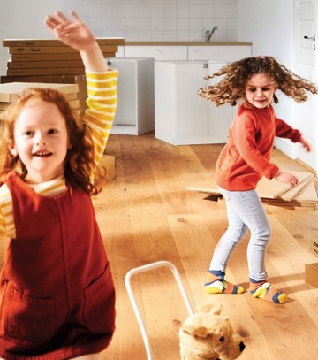
Our commitment
We have a responsibility to act.
And we are optimistic that we can create positive change for people & planet.
Three reasons why we must act
Climate change is our responsibility
Our vision compels us to act
Net zero sets the frame for future business growth

Slide 3
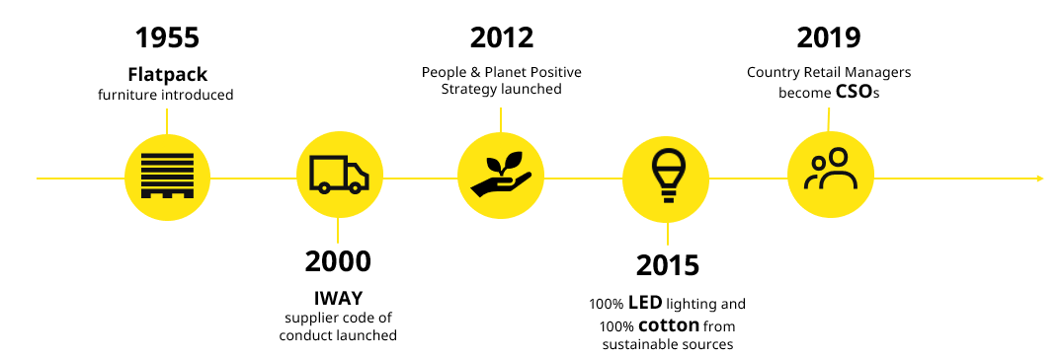
Our sustainability legacy
Notes:
IKEA was founded with a simple yet powerful vision – to create a better everyday life for the many people.
To live up to this vision in an increasingly complex world, we at Ingka must play our part in tackling some of the big challenges facing humanity. We have both a responsibility and an opportunity to make a real difference.

Slide 4
Circularity aligns with our belief that sustainability should not be a luxury that few can afford.

Slide 5
We are committed to designing all our products with circular capabilities by 2030
We aim to use only renewable or recycled materials and to provide new solutions for our customers to prolong the life of products and materials.
In 2022 55.8% of the materials we sourced were renewable and 17.3% were recycled.
Notes:
Circularity is about transforming the existing ‘take, make, waste’ linear model to the opposite – reuse, refurbish, remanufacture, and recycle.
One key piece of the puzzle is to adopt circular thinking during the design phase of the product, developing it right from the beginning so it can reach its full, circular potential one day.

Slide 6
All our products are being assessed
Circularity criteria – designed for:
Standardization
Adaptability
Recyclability
Renewable/recycled materials
Remanufacturing
Care
Repair
Disassembly & reassembly
LANEBERG
extendable table

Slide 7
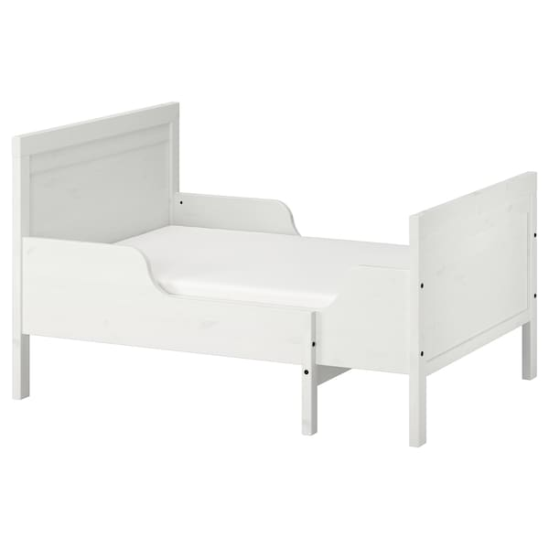
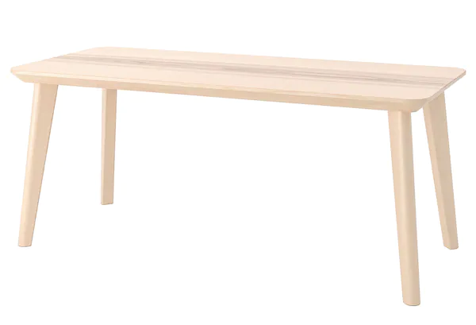
Keep your products longer
LISABO
SUNDVIK
KLIPPAN
Notes:
KLIPPAN Sofa cover is removable, washable, made from more sustainable cotton
LISABO Dining table that is durable, sturdy and easy to assemble, disassemble and reassemble, yet looks light & hand-crafted.
SUNDVIK extendable bed & mattress

Slide 8
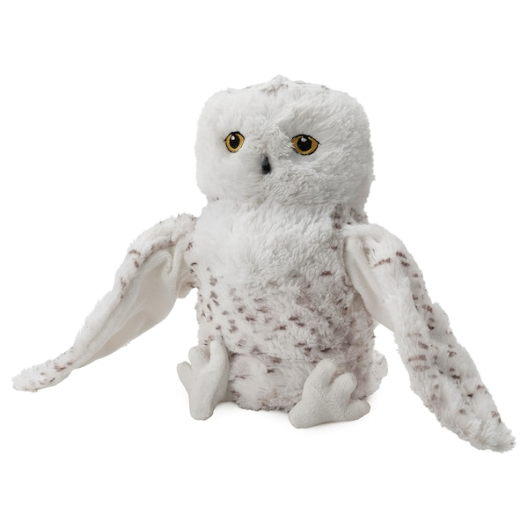
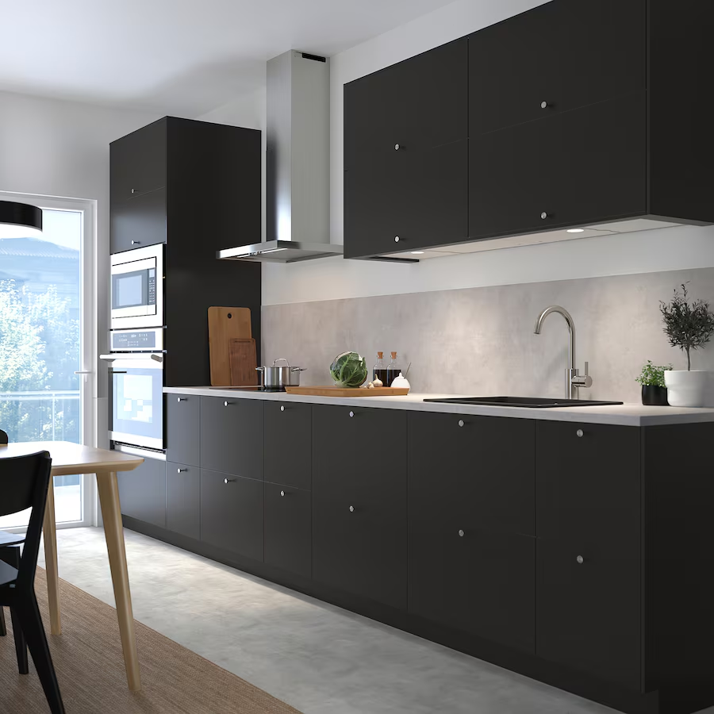
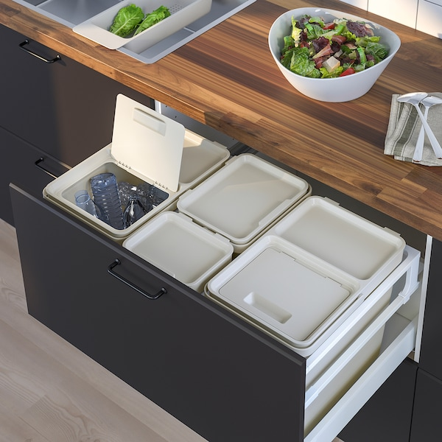
Products made of recycled material
NICKEBO
SKOGSDUVA
HÅLLBAR

Slide 9
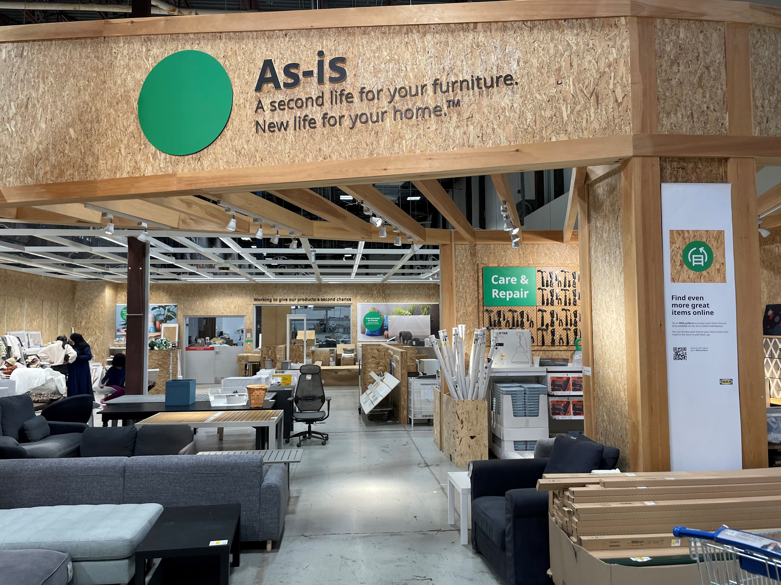
The most visited part of the store
Notes:
The most visited place in the store. The As-Is department is a place that inspires you and helps you to shop more sustainably. In As-Is you will find everything from discontinued or gently used items to items from our old displays.
By shopping in the As-Is, you can help to prolong the life of our products, prevent waste and give our products a second chance, while saving money too.
Besides shopping, the As-Is includes an interactive area where we'll hold workshops to share tips on prolonging product life and teach you how to create unique pieces by using IKEA products in unexpected ways.

Slide 10
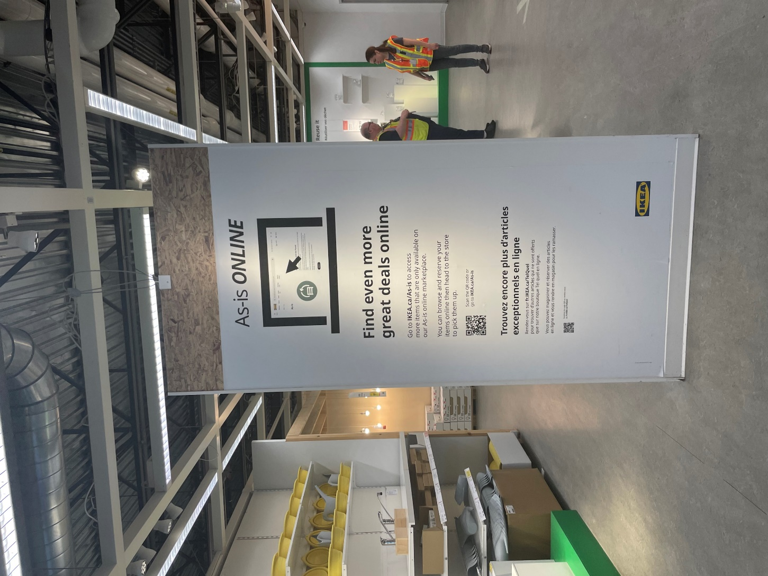
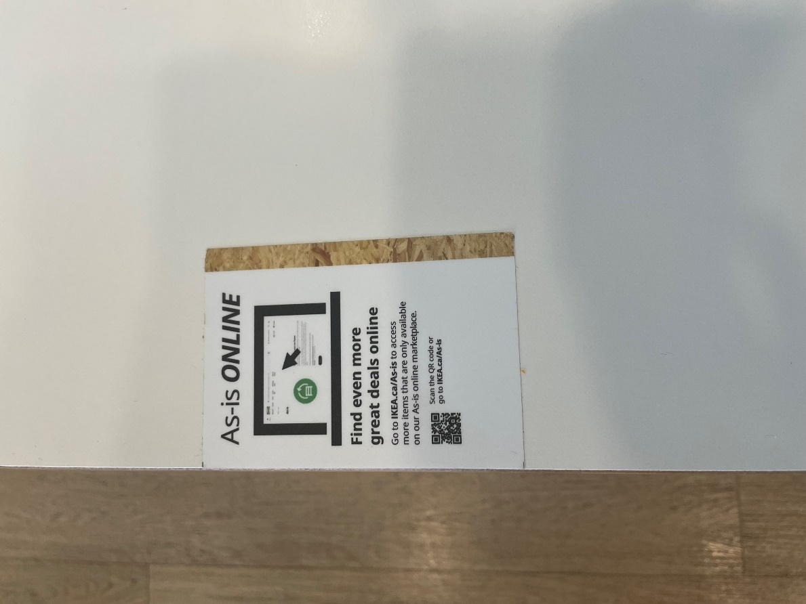
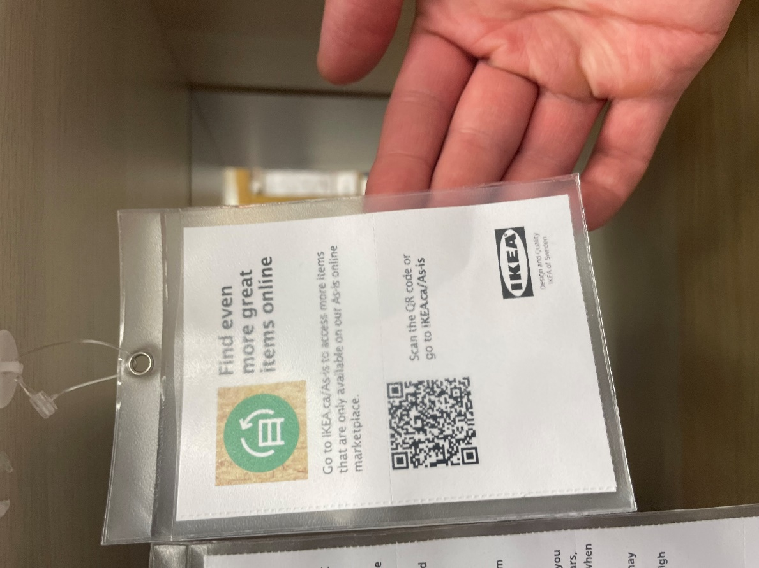
As-is online

Slide 11
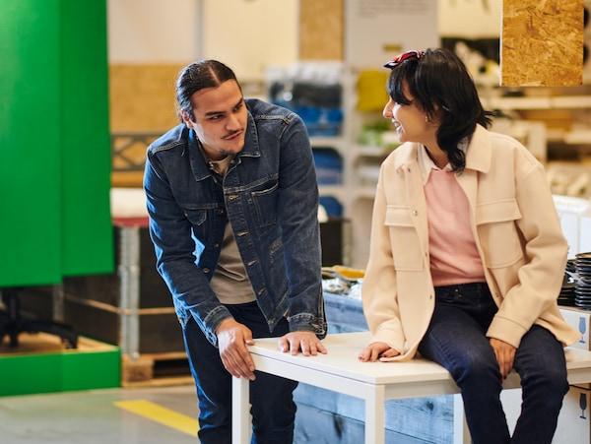
The Sell-back program
Gently used IKEA furniture can have another life through the IKEA Sell-back program.
The customer selling back a piece of furniture gets an in-store credit.
We make the furniture available in the As-is department for customers to enjoy, at a good price.
Notes:
During Black Friday – which we call Green Friday – the only discounts we offer is when people sell back their furniture – they get double the regular sell back price!

Slide 12
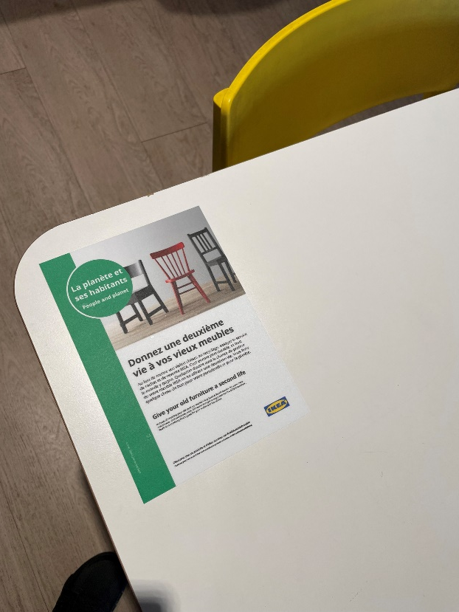
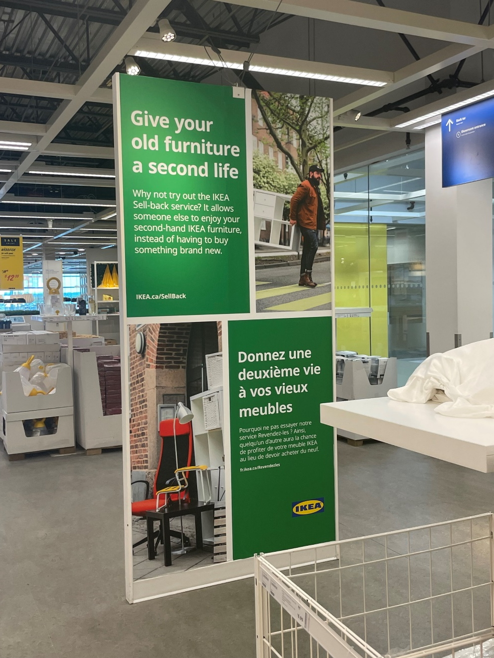
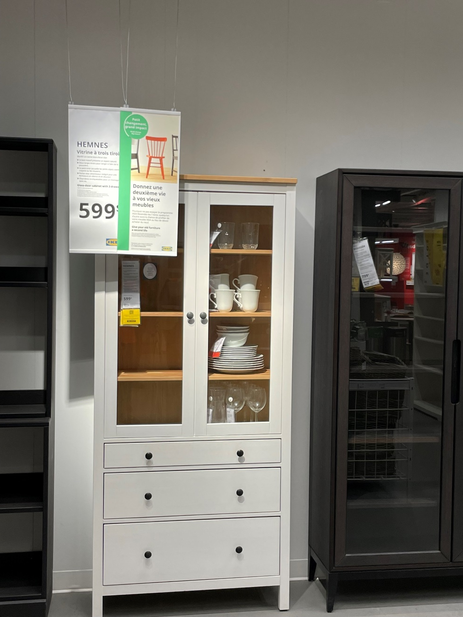
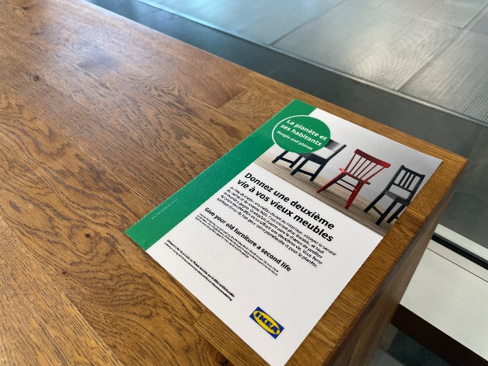
Notes:
During Black Friday – which we call Green Friday – the only discounts we offer is when people sell back their furniture – they get double the regular sell back price!

Slide 14
The Recovery Process The IKEA way
Goods from Returns & Exchanges
Straight back to stock
Fix and back to stock
Internal damage
Display withdrawals
Sell in As-Is
Use as spare parts
Donate
Recycling
Checking
Decision: Where to send the goods
Goods from inside the IKEA store
Notes:
Products returned in original package → put back to the shelf
Products returned, not used but not in original package → re-package and put back to shelf or sell in As-Is (Circular Hub) if not possible to re-package
Products returned, built and maybe used but not damaged → sell in As-Is (Circular Hub) to reduced price
Products returned, damaged → use parts as spare parts (Spare part library, free of charge for customer to enable care & reapair)
Last resort is recycling

Slide 15
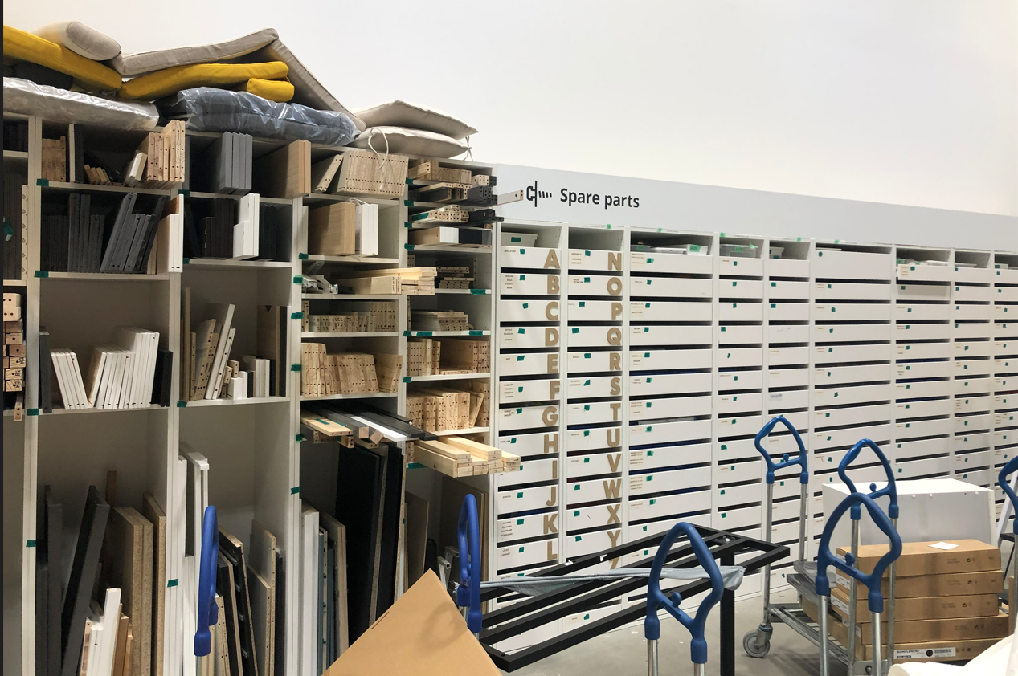
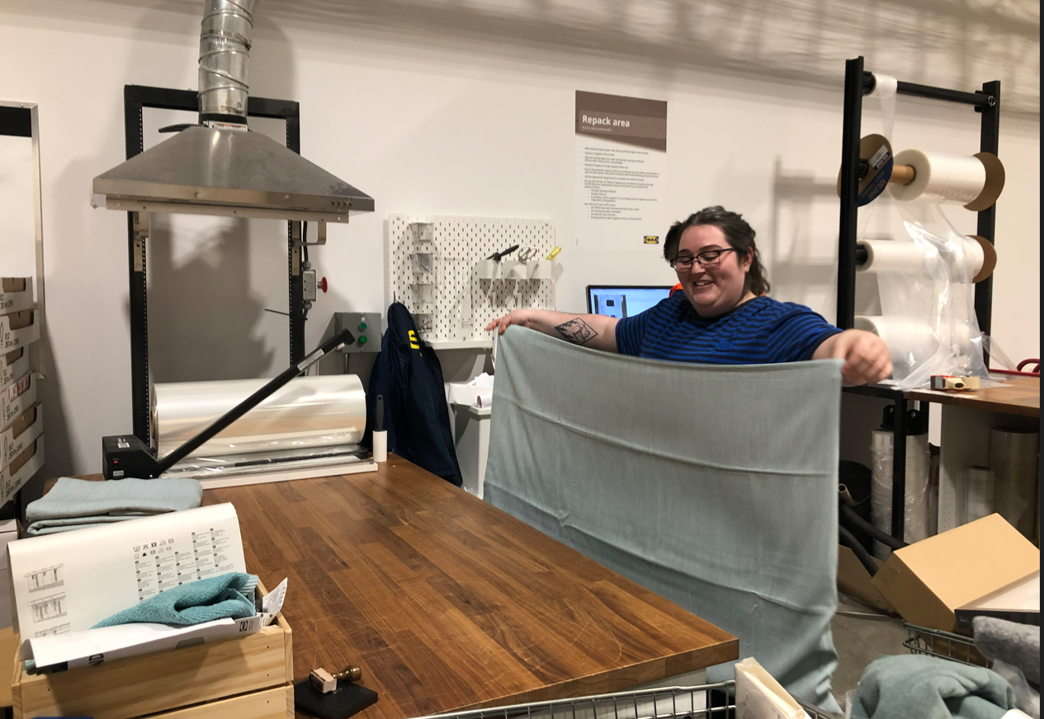
Nothing is wasted
Spare parts for almost every customer need
Repackaging returned products

Slide 16
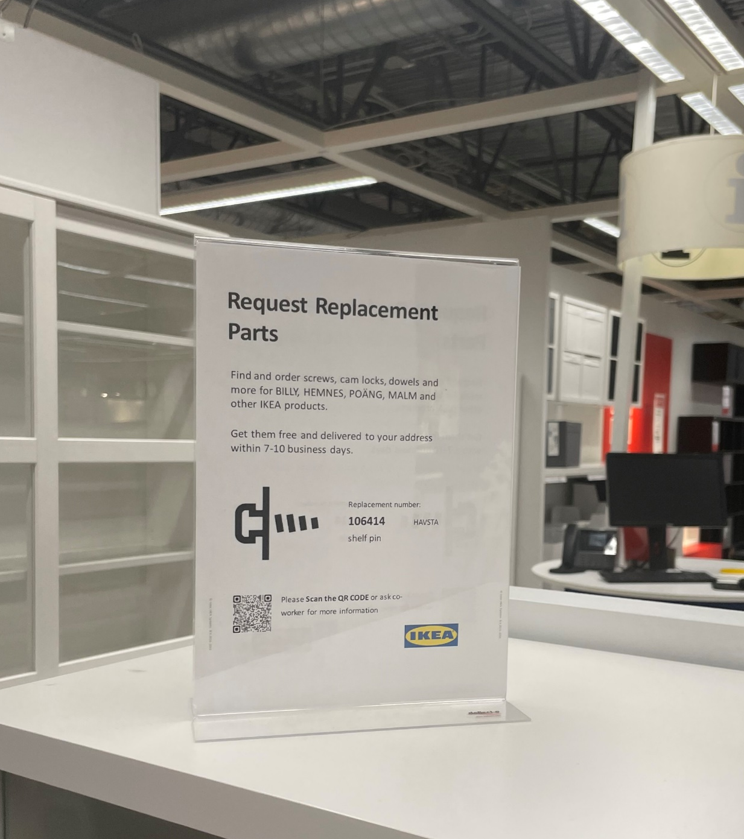
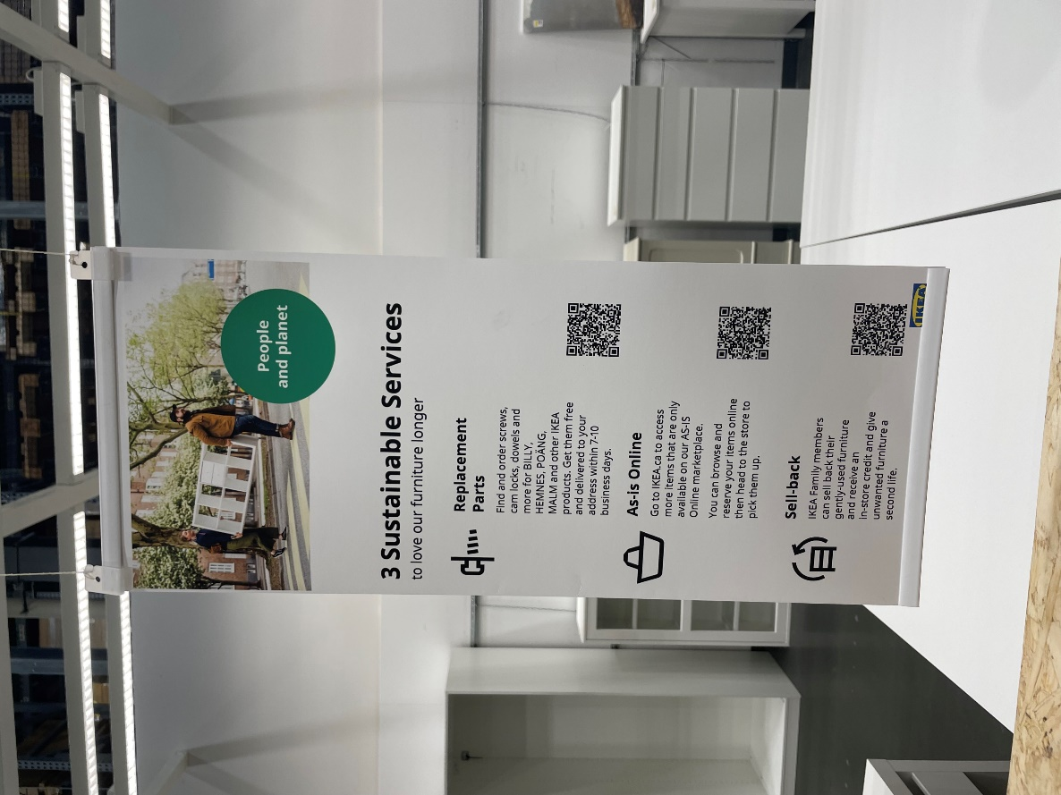
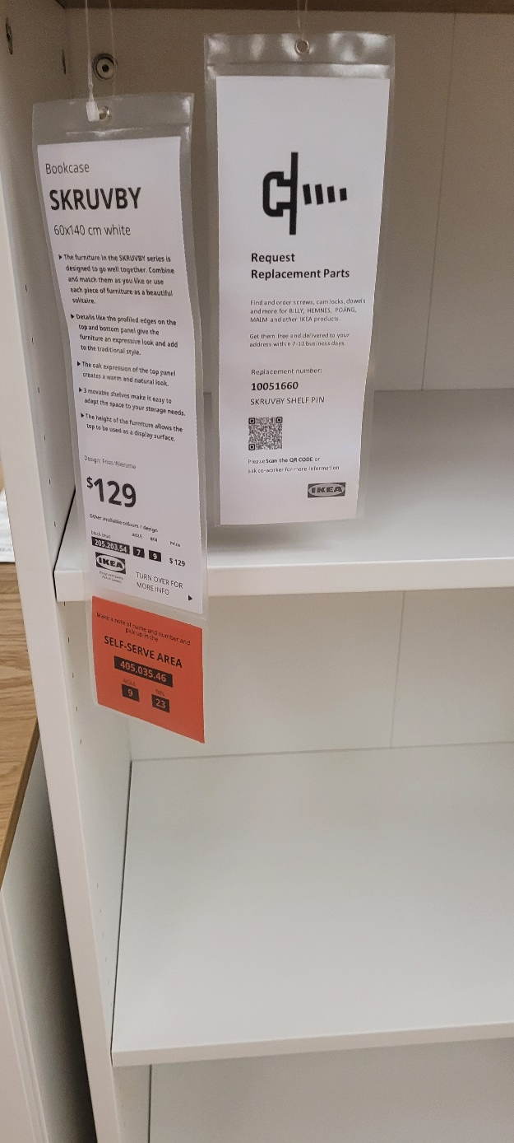
Love it longer – Replacement & spare parts

Slide 17
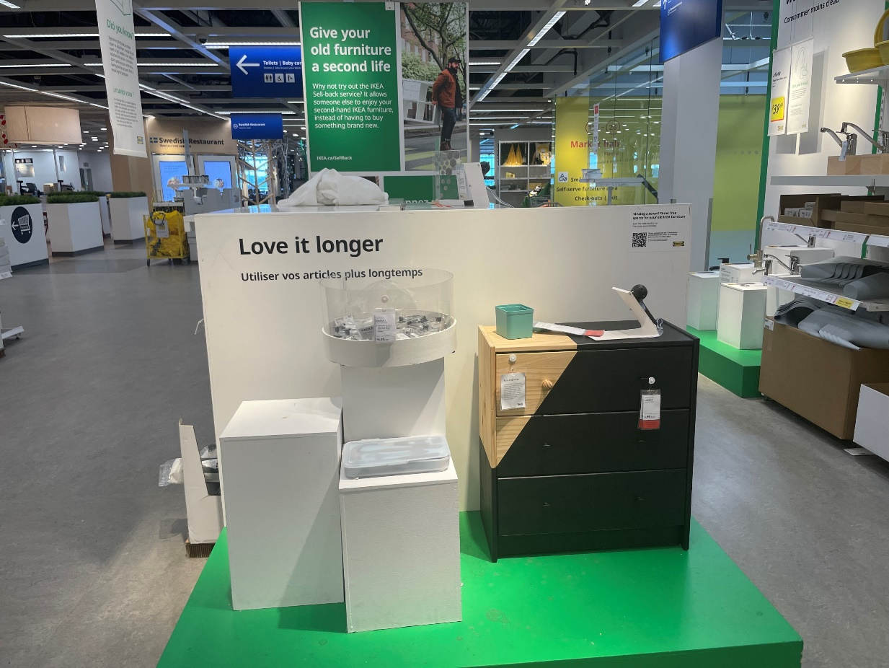
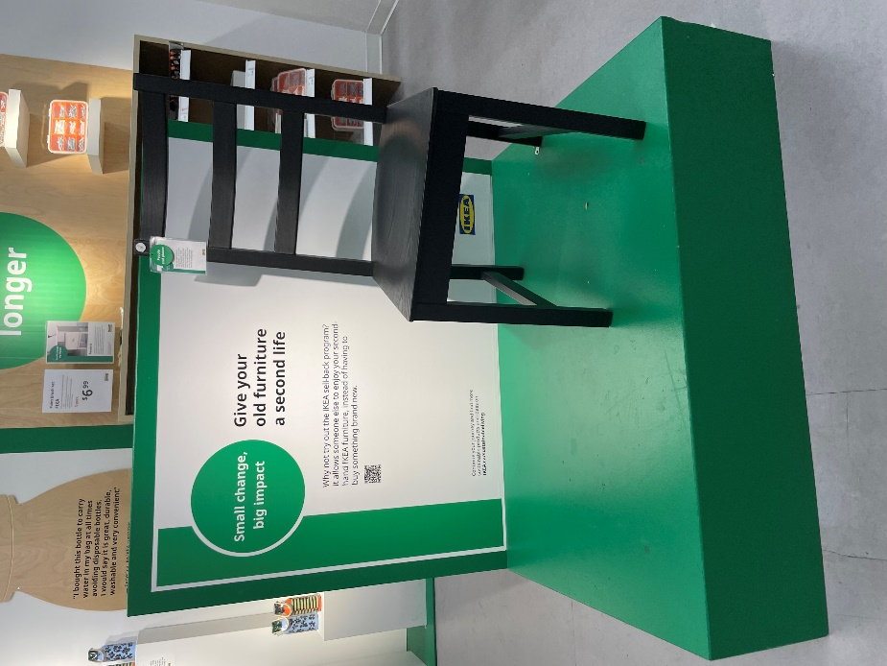
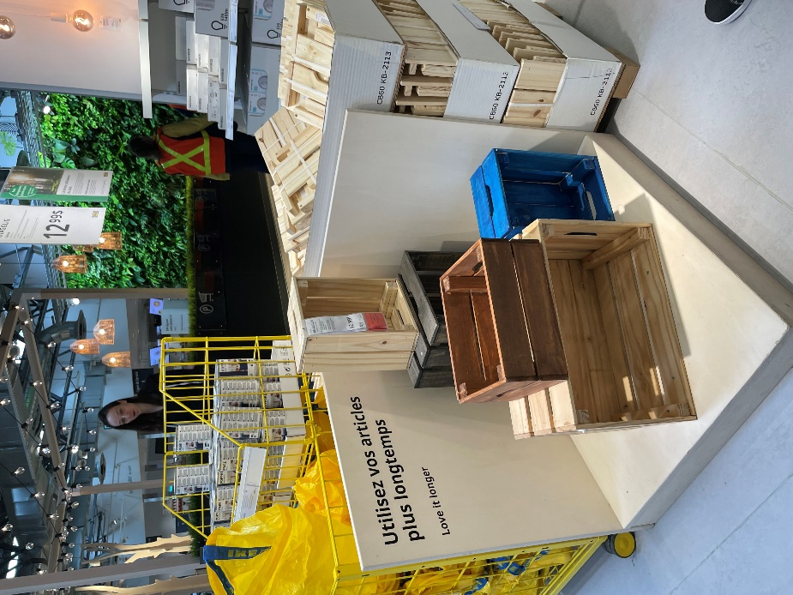
Love it longer – care & repair and upscale

Slide 18
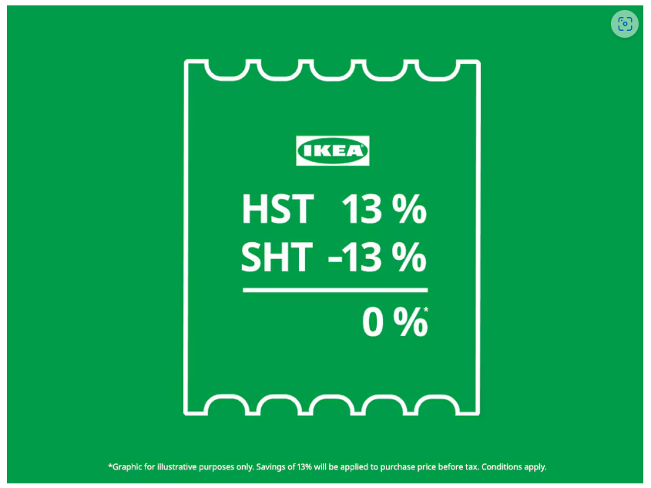
IKEA Second Hand Tax Initiative (youtube.com)
IKEA Canada Introduced the Second-Hand Tax (SHT) initiative in ON during Spring 2024 to Save Customers HST the Second Time Around.
SHT isn’t a permanent solution. IKEA Canada invites the government and like-minded companies to help them put an end to the double tax on second-hand items, so that all Canadians can shop circular for less.
Notes:
By shopping in IKEA As-is marketplace, Ontario consumers can prolong the life of products and do more with less. To kick off Earth Month, IKEA Canada announces the launch of “Second-Hand Tax” (SHT): an initiative effective in all IKEA As-is marketplaces across Ontario, in a groundbreaking move to promote sustainability and affordability.
Given the cost-of-living crisis, making life more affordable needs to be a priority. According to the annual IKEA Life at Home report, two thirds of Canadians (67%) are concerned with the general economy and more than half (57%) with household finances. That’s made IKEA Canada take a stand, urging consumers to shop sustainable and affordable second-hand options that are good for our planet and their wallets.
IKEA Canada discovered Canadians have been paying tax on second-hand items, even though the tax was already paid the first time around. Second-hand items may have lost their original look, packaging, and price, but they never lose the tax.
To tackle this issue head-on, IKEA is introducing "Second-Hand Tax" or SHT: an initiative that saves customers from paying HST twice. It's simple math. 13% (HST) - 13% (SHT) = 0%*. From April 2-11, 2024, IKEA stores across Ontario will offer SHT to IKEA Family members looking to shop more sustainably and affordably. Every item purchased in the As-is marketplace in-store will be reduced by 13% to offset the tax burden, making shopping circular even more attractive.

Slide 19
“To create a better everyday life for the many people.”
This vision goes beyond home furnishing. We want to have a positive impact on the world – from the communities where we source our raw materials to the way our products help our customers live a more sustainable life at home.

Slide 20
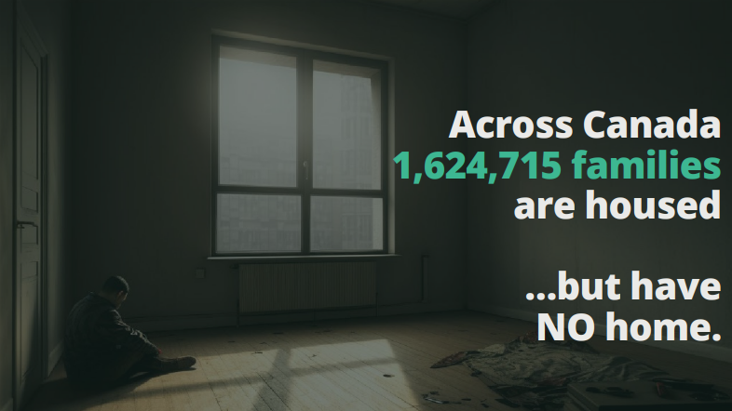

Slide 21
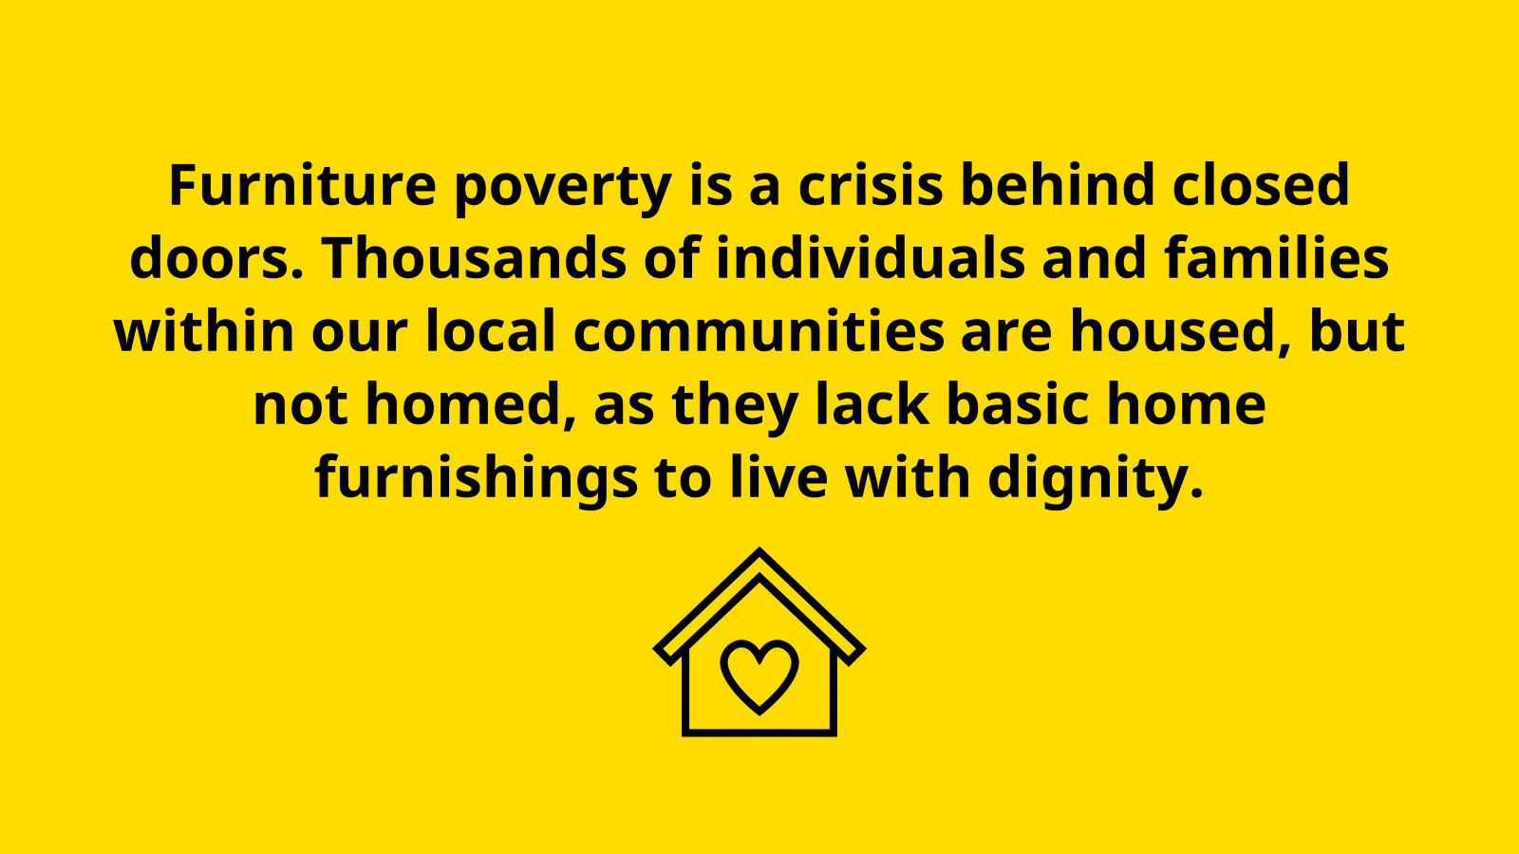
Notes:
One emergency from being homeless.
Rent, Food, Utilities are prioritized
Families living on minimum wage or government assistance
- Wages $5,300 Deductions -$1,400
Net pay $3,900 Govt Assist $825
Rent -$2,200 Food -$1,100
Utilities -$200 Public Transport -$150
ChildCare -$950 Phone Plan -$100
What's Left? $25

Slide 22
Furnishing a home with $25 a month?
Notes:
One emergency from being homeless.
Rent, Food, Utilities are prioritized
Families living on minimum wage or government assistance
- Wages $5,300 Deductions -$1,400
Net pay $3,900 Govt Assist $825
Rent -$2,200 Food -$1,100
Utilities -$200 Public Transport -$150
ChildCare -$950 Phone Plan -$100
What's Left? $25

Slide 23
$4000 – 8000 To furnish one empty housing unit.
per family

Slide 24
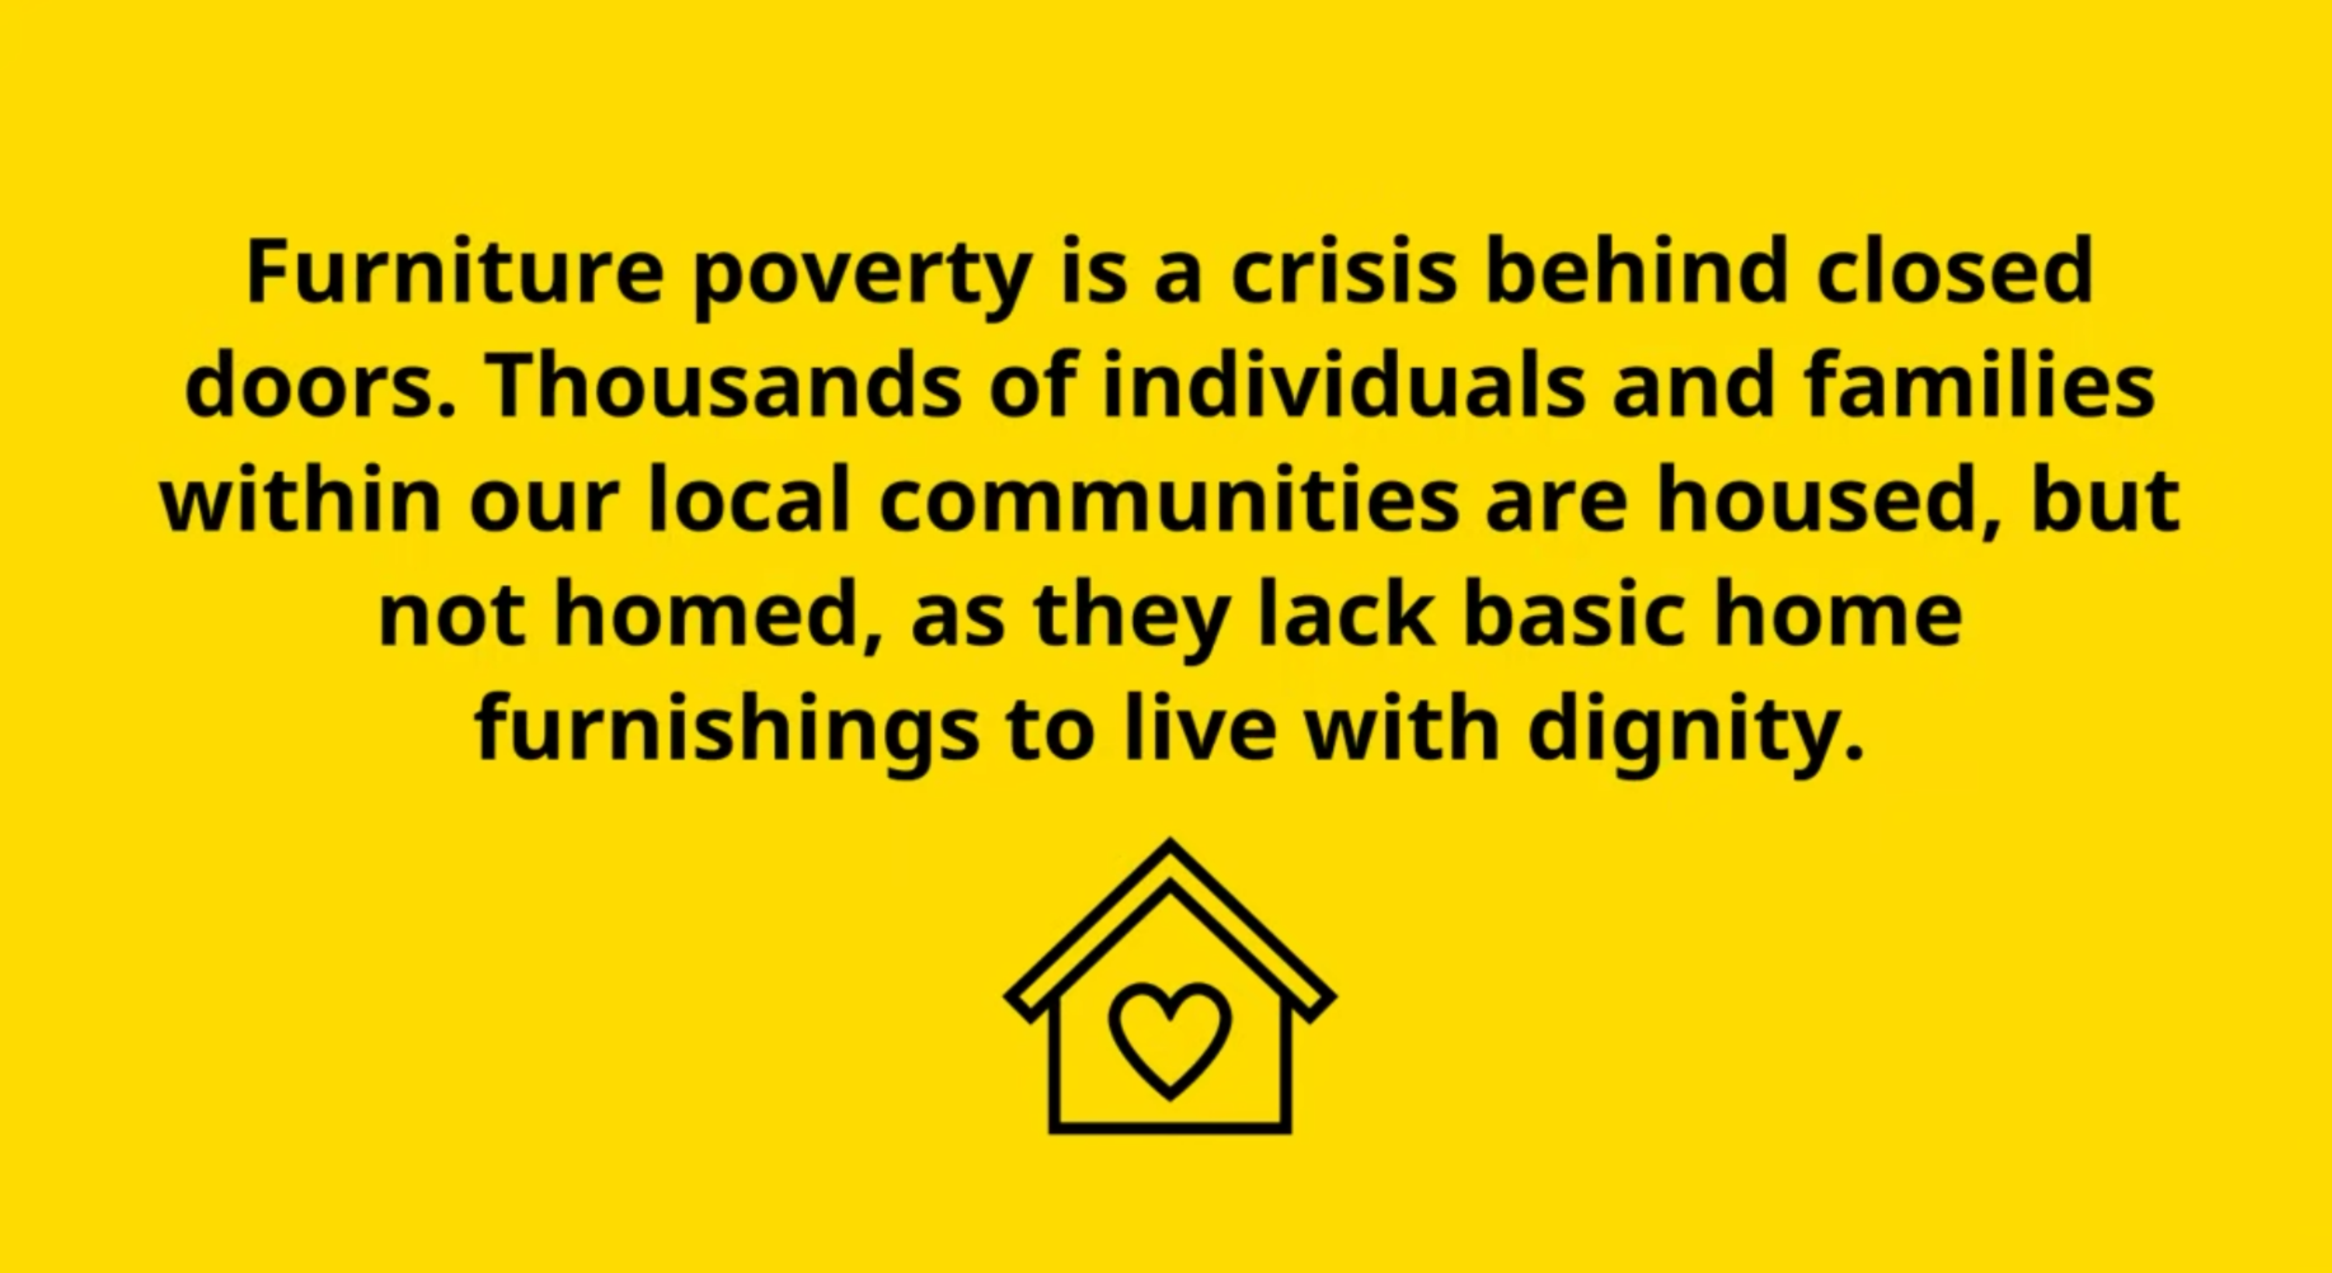
Children sleeping on floors
Notes:
After rent, utilities, and food…

Slide 25
+

Slide 26
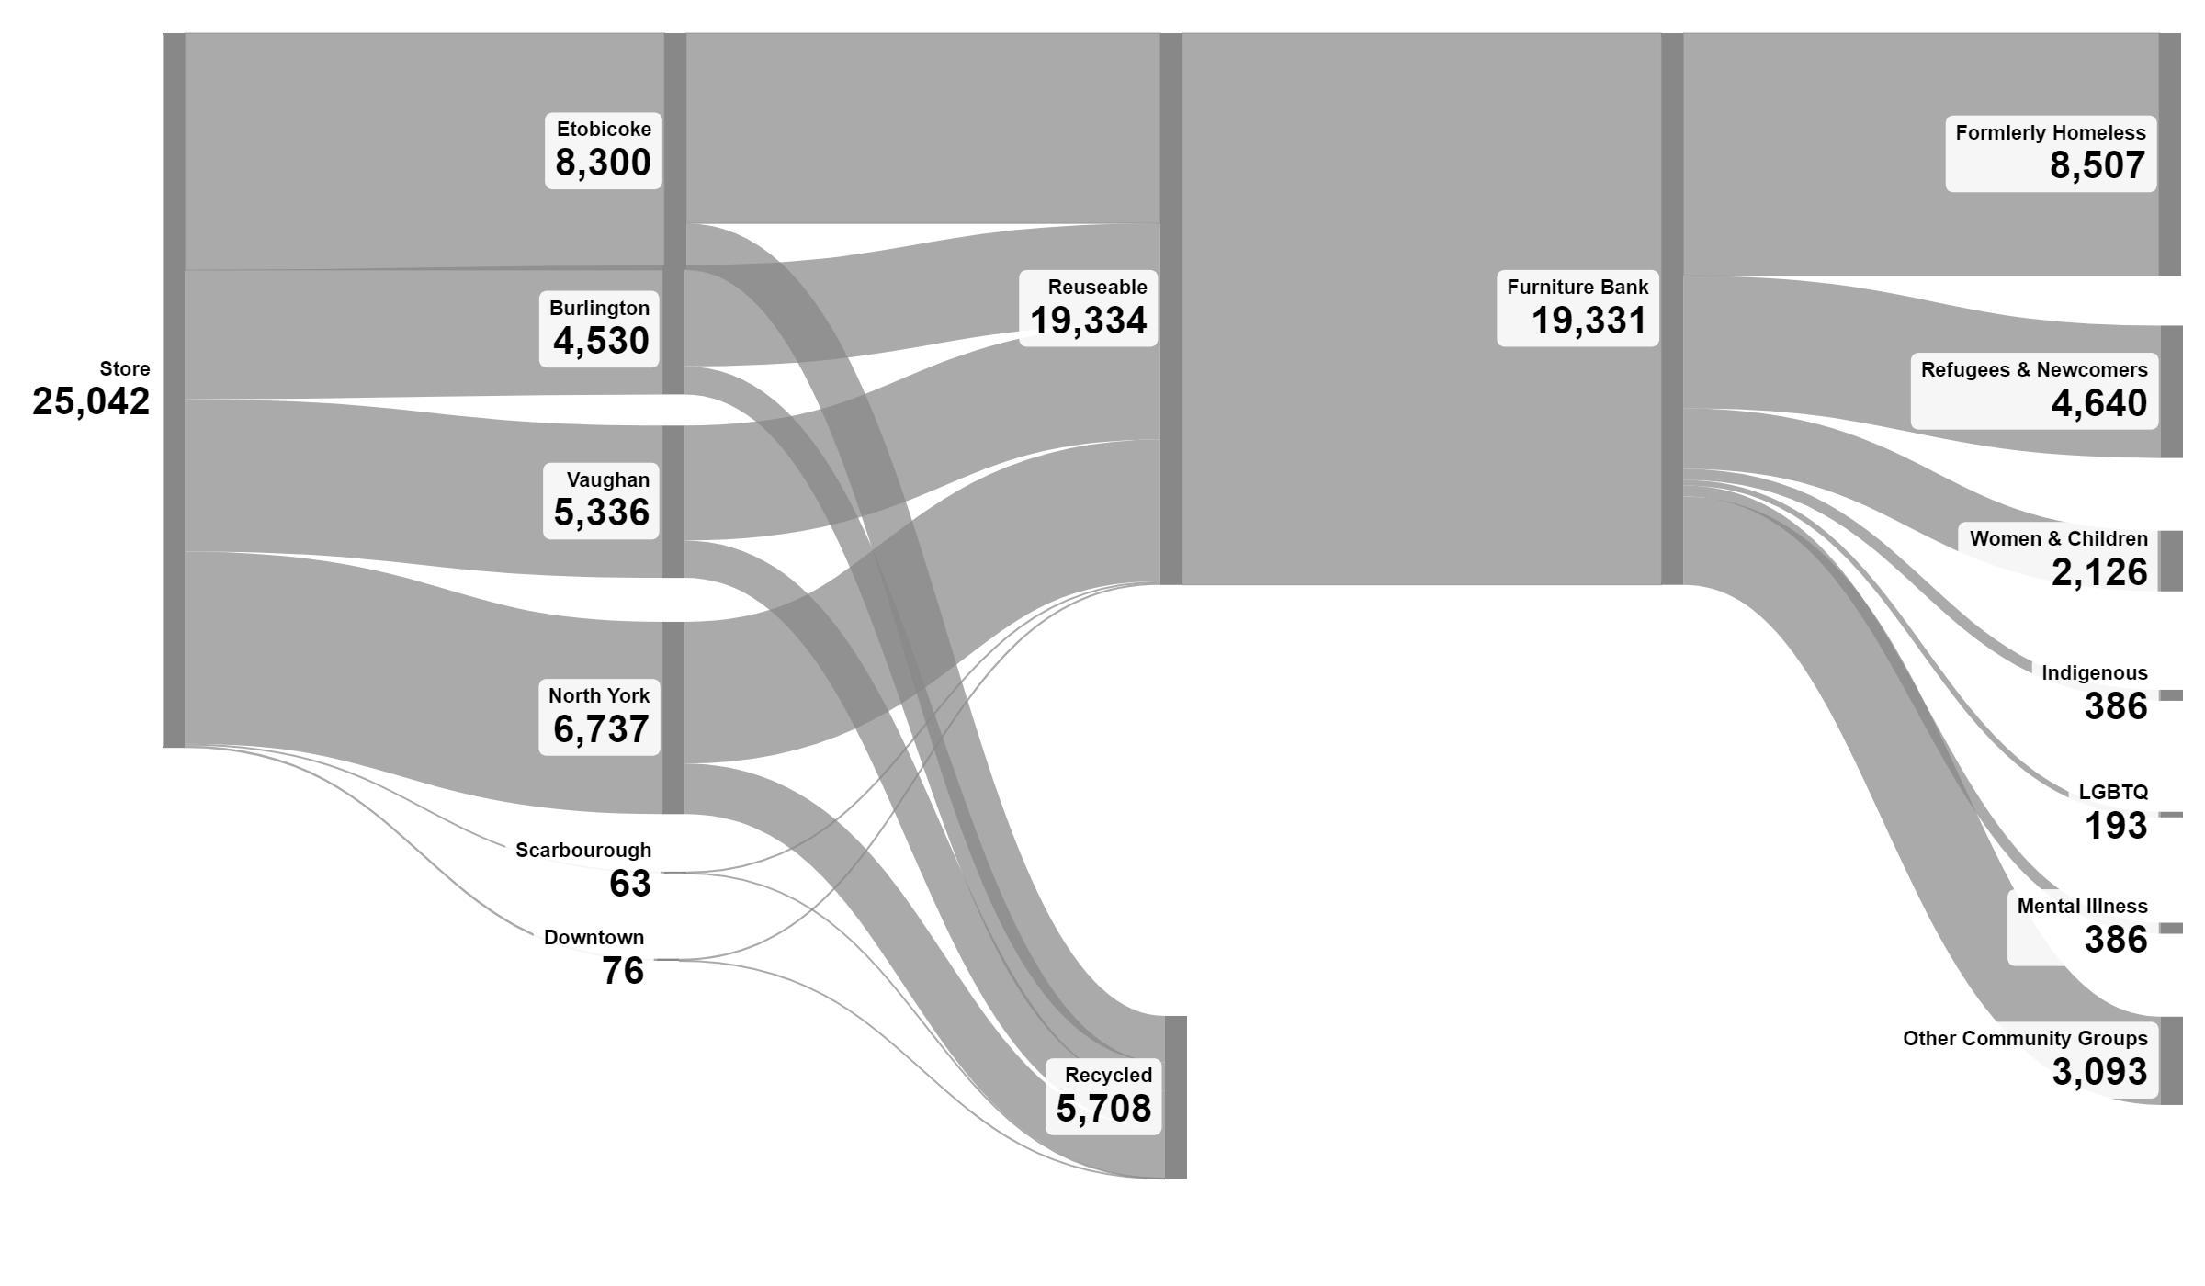
A second life for returned mattresses
Lifetime stats to September 2024
Notes:
DAN
Capture the huge stream of returned and overstock goods and keep them from landfill

Slide 27
Notes:
35% children

Slide 28
Canada-wide solution Social & Circular Impact Model

Slide 29
How can you support?
+

Slide 30
“Waste of resources is one of the greatest diseases of mankind.”
Ingvar Kamprad, founder of IKEA, 1976

